Slide 1
Browser-Based Digital Preservation
Mat Kelly
Web Science and Digital Libraries (WS-DL) Research Lab
Department of Computer Science
http://ws-dl.cs.odu.edu
July 7, 2014

Slide 2
What This Will Be About
Saving Things on Live Web to Web Archives
State of the Art
Barriers
Dynamics of Digital Preservation Components
Means of Preservation (e.g., crawlers)
Means of Replay (e.g., Wayback)
Outstanding and Unsolved Issues in DigPres

Slide 3
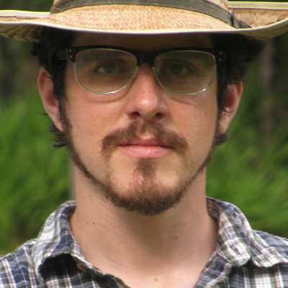
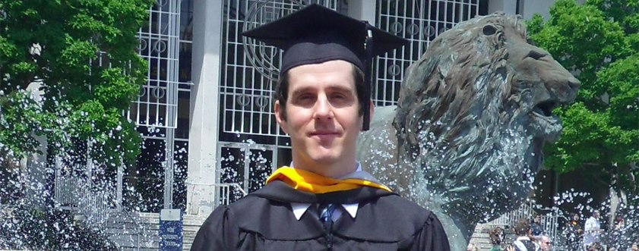
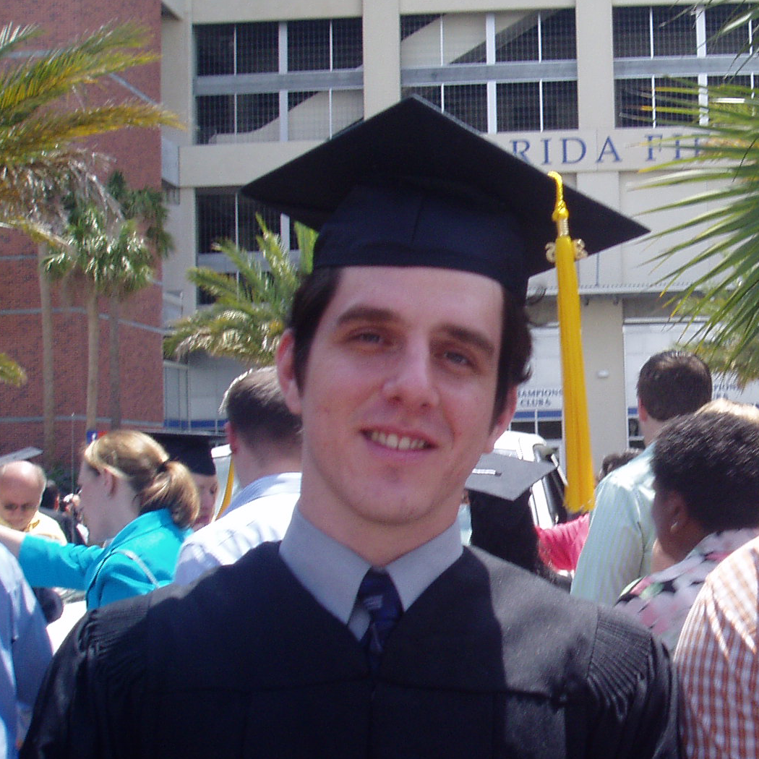
The Speaker, Mat Kelly:
3rd Year PhD student
MS Degree:
BS Degree:
Previously a researcher at BMW
Currently programmer @ NASA Langley
Research Assistant @ ODU WS-DL Research Lab
My homepage: http://www.cs.odu.edu/~mkelly

Slide 4
Quick Primer: The Web
What It Is
Client-Server Messaging + Payload
HTML, Images, JavaScripts, Multimedia, and more!
Where It Resides
Live web: remote servers, distributed content

Slide 5
Quick Primer: HTTP
http://mysite.com/~jsmith/myPage.html
SCHEME/PROTOCOL
domain
resource path on server
Client Requests Resource
YES!
200 OK + Resource
NO, it’s moved!
300-code + URI
Server Responds
NO, it’s gone!
404
user agent (browser)
Server
Resource Exists?
Respond With
Embedded Content in Resp?
e.g., images, JavaScript
YES!
200 OK + Resource
NO, it’s moved!
300-code + URI
NO, it’s gone!
404
ETC.

Slide 6
How The Web Is Used
Web browser accesses website via URI
Browser requests site’s contents from server
Browser displays site’s contents
Usually requiring multiple requests for embedded resources
GET / HTTP/1.1
Host: mysite.com
BEHIND THE SCENES
HTTP/1.1 200 OK
Content-Type: text/html
<!DOCTYPE html>
<html>
<head> …
HTTP Response
Header
HTTP Response
Entity

Slide 7
Returning to a Page on the Live Web
Lookup by URI
But Site’s Gone
Lookup in Web Archives
GET / HTTP/1.1
Host: mysite.com
HTTP/1.1 404 NOT FOUND
Content-Type: text/html

Slide 8
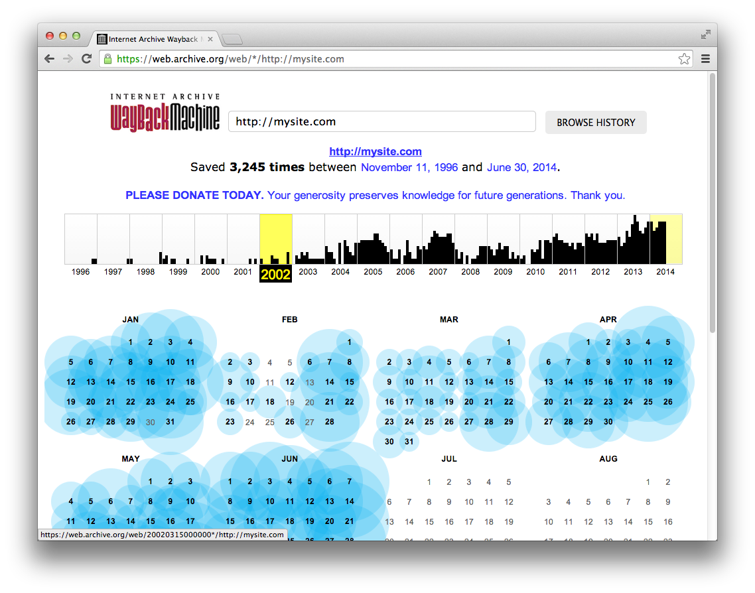
Returning to a Page on the Live Web
USING THE ARCHIVES
Lookup by URI at Internet Archive
✓ SUCCESS
Likely Preserved If…
Popular
Surface (e.g., no auth)
Simple (no fancy JS)

Slide 9
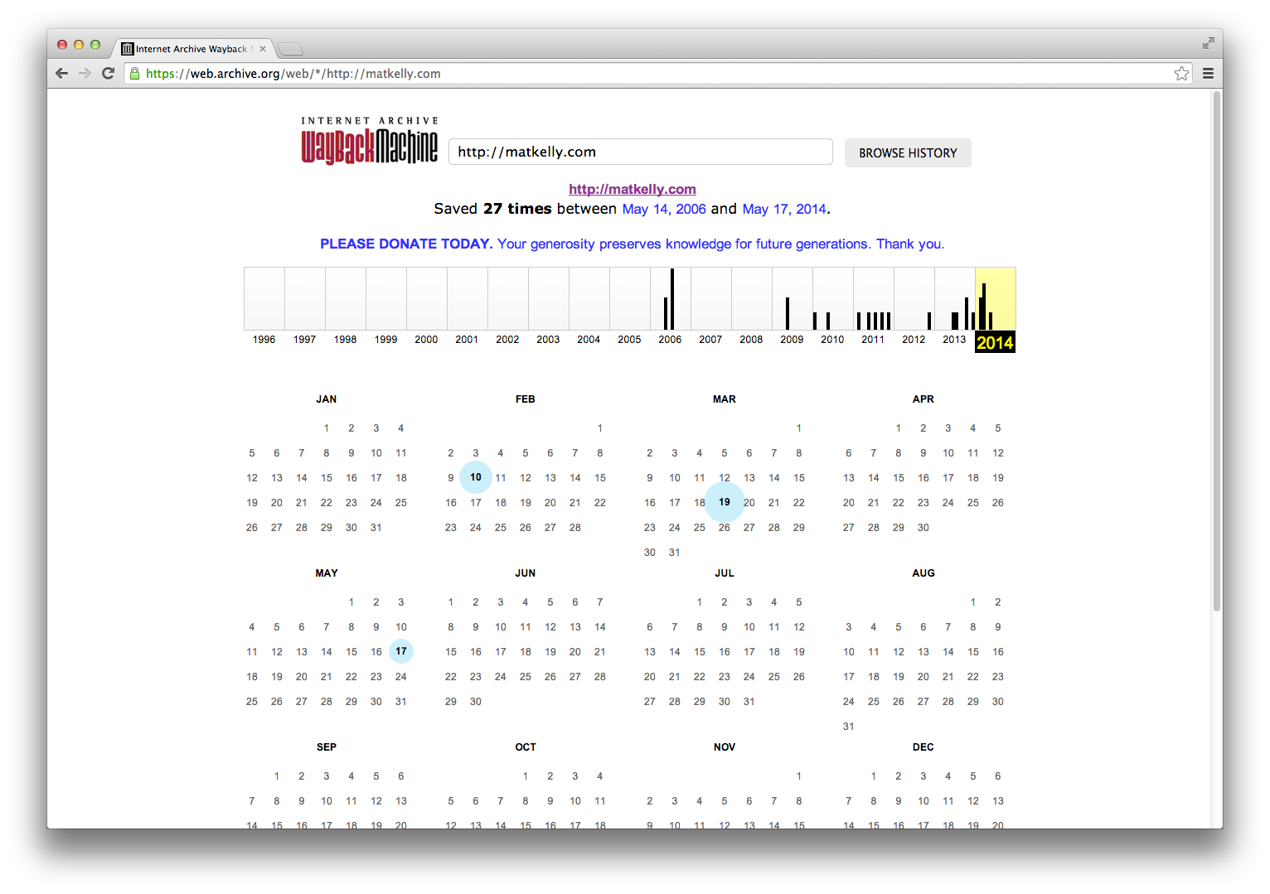
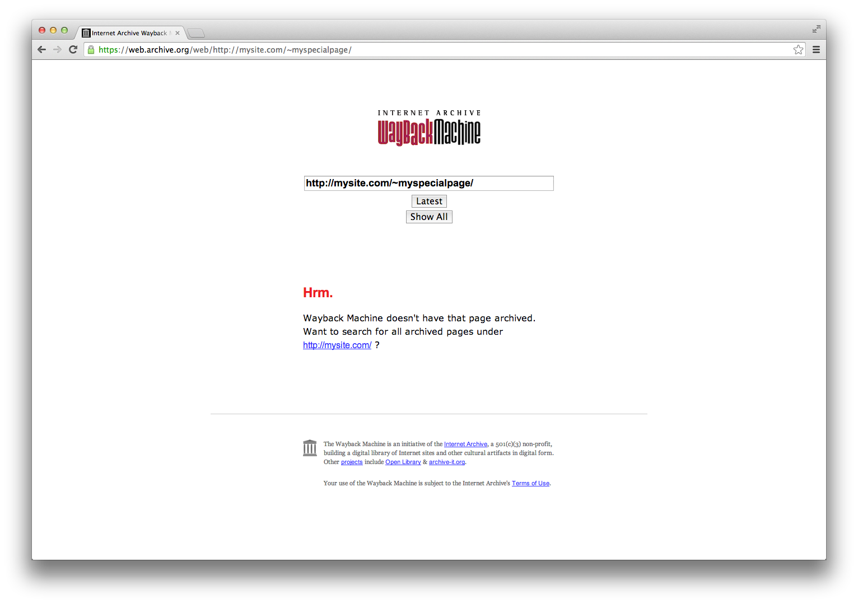
Site Popularity Affects Archival Presence
More Popular
Well preserved
Less Popular
Less preserved
Niche Site
Likely not preserved

Slide 10
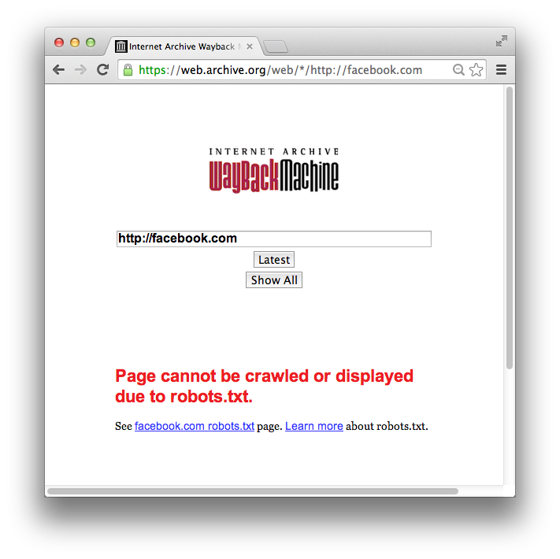
Sites Not On Surface Web are Likely Not Archived
Sites can restrict being crawled
Whose data is it anyway?
Robots.txt can limit
Crawler (by user-agent)
Paths/files/whole site

Slide 11
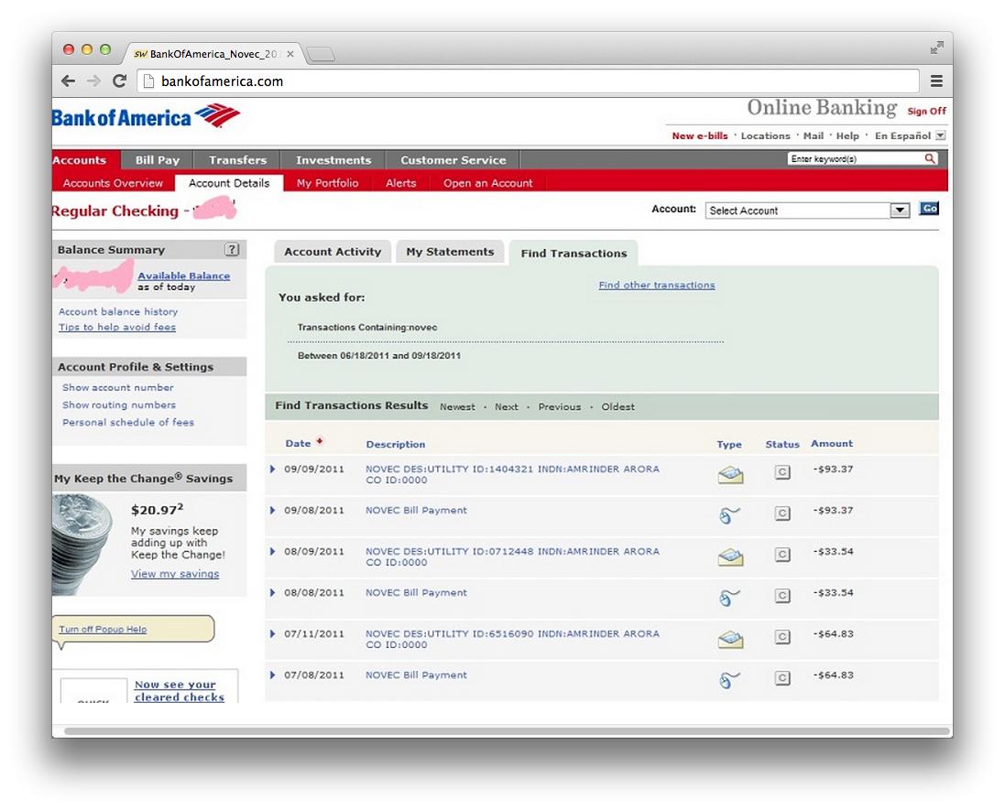
Sites Not On Surface Web are Likely Not Archived
Not everything ought to be in public archives
…but we might still want to preserve these pages.
e.g., our FB news feed

Slide 12
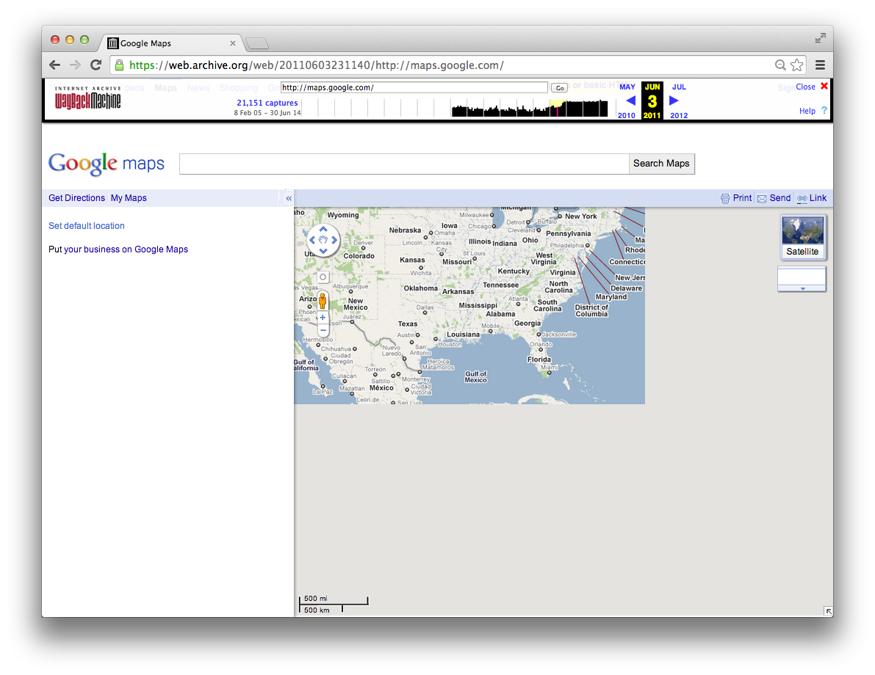
When the Browsing Tool Changes The Result is Inconsistent
Interactive sites
frequently do not have all resources required for replay in the archives

Slide 13
Recall:
Likely a Web Page Is Preserved If…
Popular
Surface (e.g., no authentication required)
Simple (no fancy JavaScript)

Slide 14
From This, We Can Surmise:
A page will be UNLIKELY or INSUFFICIENTLY preserved if:
Not Popular
On the Deep Web or Behind Authentication
Contains Fancy Effects or Asynchronously Loaded Resources

Slide 15
Why and What Can Be Done
A page will be UNLIKELY or INSUFFICIENTLY preserved if:
Not Popular
On the Deep Web or Behind Authentication
Contains Fancy Effects or Asynchronously Loaded Resources
Internet Archive chooses What is Preserved

Slide 16
Why and What Can Be Done
A page will be UNLIKELY or INSUFFICIENTLY preserved if:
Not Popular
On the Deep Web or Behind Authentication
Contains Fancy Effects or Asynchronously Loaded Resources
Preserve from the Browser Instead of
Delegating by URI

Slide 17
Why and What Can Be Done
A page will be UNLIKELY or INSUFFICIENTLY preserved if:
Not Popular
On the Deep Web or Behind Authentication
Contains Fancy Effects or Asynchronously Loaded Resources
Leverage the Browser’s Native JavaScript
rendering engine

Slide 18
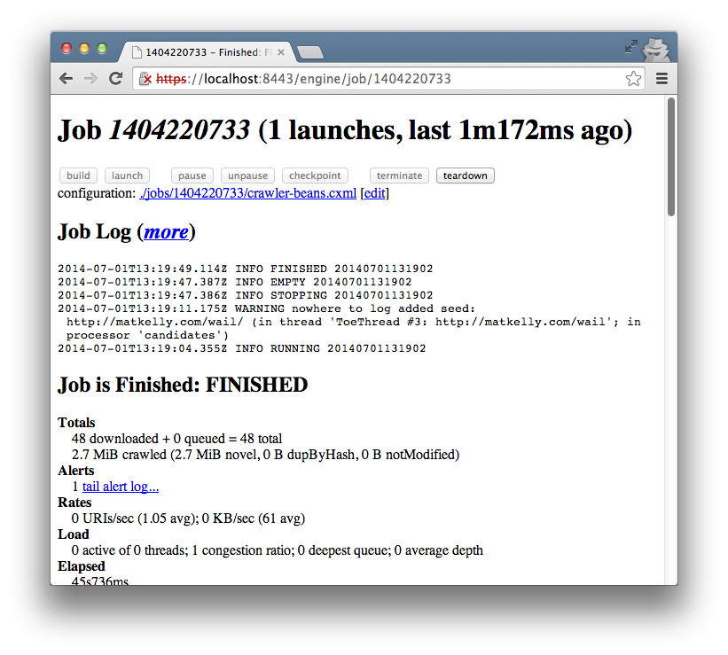
State of the Art:
Internet Archive’s archival crawler
Open source, also deployed @archive.org
Command-line driven
Web-based GUI
Allows list of URIs to be crawled, frequency, crawl depth, etc.
On user’s own Heritrix deployment
Generates Web ARChive (WARC) files

Slide 19
The Web ARChive (WARC) File Format
WARC/1.0
WARC-Type: warcinfo
WARC-Filename: test.warc
Content-Length: 42
Format: WARC File Format 1.0
WARC info
Record
28500
Multiple text-based record types in a file
Supports arbitrary data types on web
Preserves HTTP information for replaying content
WARC/1.0
WARC-Type: request
WARC-Target-URI: http://mysite.com
WARC-Date: 2014-05-10T12:11:03Z
WARC-Concurrent-To: <urn:uuid:ba53adfd-4bd0-9a53-9396-b0dd77e39353>
WARC-Record-ID: <urn:uuid:f8e095f3-7b77-f2e6-f592-ce0b63a32f36>
Content-Length: 115
GET / HTTP/1.1
User-Agent: Mozilla/5.0
WARC request
Record
WARC/1.0
WARC-Type: response
WARC-Target-URI: http://mysite.com
WARC-Concurrent-To: <urn:uuid:ba53adfd-4bd0-9a53-9396-b0dd77e39353>
WARC-Record-ID: <urn:uuid:f93eafa7-24c5-c29f-e17f-e0627201b7f1>>
Content-Length: 11262
HTTP/1.1 200 OK
<!DOCTYPE html><html>
<head>
<body>...
WARC response
Record

Slide 20
WARC Anatomy
WARC Records each have a header and a payload
One warcinfo/WARC
warcmetadata optional
Describe files
can have multiple/file
Req/Resp records document HTTP transactions @archive time
MyArchive.warc
warcinfo record header
warcinfo record payload
warcmetadata record header
warcmetadata record payload
warcrequest record header
warcrequest record payload
warcresponse record header
warcreponse record payload
warcrequest record header
warcrequest record payload
warcresponse record header
warcreponse record payload

Slide 21
Reading WARCs
“Replaying” content as it once was versus viewing a static web page
Deployed at Internet Archive (archive.org)
Open Source software
You can deploy your own Wayback!
Indexes WARCs, allows content to be accessible from web interface

Slide 22
But the Issue Remains…
A crawler
changes the capture context
from the browser

Slide 23
High Level Requirements WARC Creation Software
Intuitive to use
cf. Heritrix and Wayback are difficult to setup
Comply with WARC ISO standard
Capture JavaScript
Capture content behind authentication
Allow a user to execute through the browser
On demand, without need to delegate via URI

Slide 24
WARCreate “Create WARC files from any webpage”
On Page Load
Generate warcinfo record
Save HTTP Requests, Responses
Content as Strings
On Secondary Content Loaded
Repeat 1.2. and Concatenate
On Generate WARC command
Create Blob from String
Provide Blob to FileSaver library

Slide 25
Google Chrome’s Webrequest API
onBeforeSendHeaders - HTTP request headers
onHeadersReceived() –HTTP response headers
onBeforeRequest() –HTTP 3XX responses
onResponseStarted() - Payload
https://developer.chrome.com/extensions/webRequest

Slide 26
Payloads Captured
Target information can be captured with webRequest
File/Session descriptors generated at archive time
Payload headers generated once payload captured
Templating system used
MyArchive.warc
warcinfo record header
warcinfo record payload
warcmetadata record header
warcmetadata record payload
warcrequest record header
✓
warcrequest record payload
warcresponse record header
✓
warcreponse record payload
warcrequest record header
✓
warcrequest record payload
warcresponse record header
✓
warcreponse record payload

Slide 27
A Real warcinfo
Template
Generated @ archive time
Self-descriptive
WARC/1.0
WARC-Type: warcinfo
WARC-Date: 2014-06-30T22:56:06Z
WARC-Filename: 20140630180606900.warc
WARC-Record-ID: <urn:uuid:7fc954f0-e291-279f-5b6b-5b97aeb437bd>
Content-Type: application/warc-fields
Content-Length: 458
software: WARCreate/0.2014.6.2 http://warcreate.com
format: WARC File Format 1.0
conformsTo: http://bibnum.bnf.fr/WARC/WARC_ISO_28500_version1_latestdraft.pdf
isPartOf: basic
description: Crawl initiated from the WARCreate Google Chrome extension
robots: ignore
http-header-user-agent: Mozilla/5.0 (Macintosh; Intel Mac OS X 10_9_3) AppleWebKit/537.36 (KHTML, like Gecko) Chrome/35.0.1916.153 Safari/537.36
http-header-from: warcreate@matkelly.com

Slide 28
A Real warcmetadata
Template
Generated @ archive time
Self-descriptive
WARC/1.0
WARC-Type: metadata
WARC-Target-URI: http://matkelly.com/
WARC-Date: 2014-06-30T22:56:06Z
WARC-Concurrent-To: <urn:uuid:dddc4ba2-c1e1-459b-8d0d-a98a20b87e96>
WARC-Record-ID: <urn:uuid:6fef2a49-a9ba-4b40-9f4a-5ca5db1fd5c6>
Content-Type: application/warc-fields
Content-Length: 1938 outlink: http://matkelly.com/_images/logo.png E =EMBED_MISC
outlink: http://matkelly.com/resume/ L a/@href

Slide 29
A Real warcrequest
Template
Generated @ archive time
Self-descriptive
WARC/1.0
WARC-Type: request
WARC-Target-URI: http://matkelly.com/
WARC-Date: 2014-06-30T22:56:06Z
WARC-Concurrent-To: <urn:uuid:ba53adfd-4bd0-9a53-9396-b0dd77e39353>
WARC-Record-ID: <urn:uuid:f8e095f3-7b77-f2e6-f592-ce0b63a32f36>
Content-Type: application/http; msgtype=request
Content-Length: 317
GET / HTTP/1.1
Accept: text/html,application/xhtml+xml,application/xml;q=0.9,image/webp,*/*;q=0.8
User-Agent: Mozilla/5.0 (Macintosh; Intel Mac OS X 10_9_3) AppleWebKit/537.36 (KHTML, like Gecko) Chrome/35.0.1916.153 Safari/537.36
Accept-Encoding: gzip,deflate,sdch
Accept-Language: en-US,en;q=0.8,de-DE;q=0.6
HTTP Request
header

Slide 30
A Real warcresponse
Template
Generated @ archive time
Self-descriptive
WARC/1.0
WARC-Type: response
WARC-Target-URI: http://matkelly.com/
WARC-Date: 2014-06-30T22:56:06Z
WARC-Record-ID: <urn:uuid:f93eafa7-24c5-c29f-e17f-e0627201b7f1>
Content-Type: application/http; msgtype=response
Content-Length: 12662
HTTP/1.1 200 OK
Date: Mon, 30 Jun 2014 22:56:04 GMT
Server: Apache
Vary: Accept-Encoding
Content-Encoding: gzip
Content-Length: 4824
Keep-Alive: timeout=2, max=100
Connection: Keep-Alive
Content-Type: text/html
<!DOCTYPE html><html xmlns="http://www.w3.org/1999/xhtml" xml:lang="en" lang="en"><head>
HTTP Response
header
HTTP Response
body

Slide 31
The File System Problem
WARC strings must be saved to file system
JS provides access to HTML5 localStorage
Limited to sandbox, 5 MB
NEW Chrome extension API allows unlimited MB
chrome.storage instead of localStorage
HTML5 W3C saveAs() support is limited
FileSaver.js provides polyfill!
Limited to ~ 360 MB/file
https://github.com/eligrey/FileSaver.js/

Slide 32
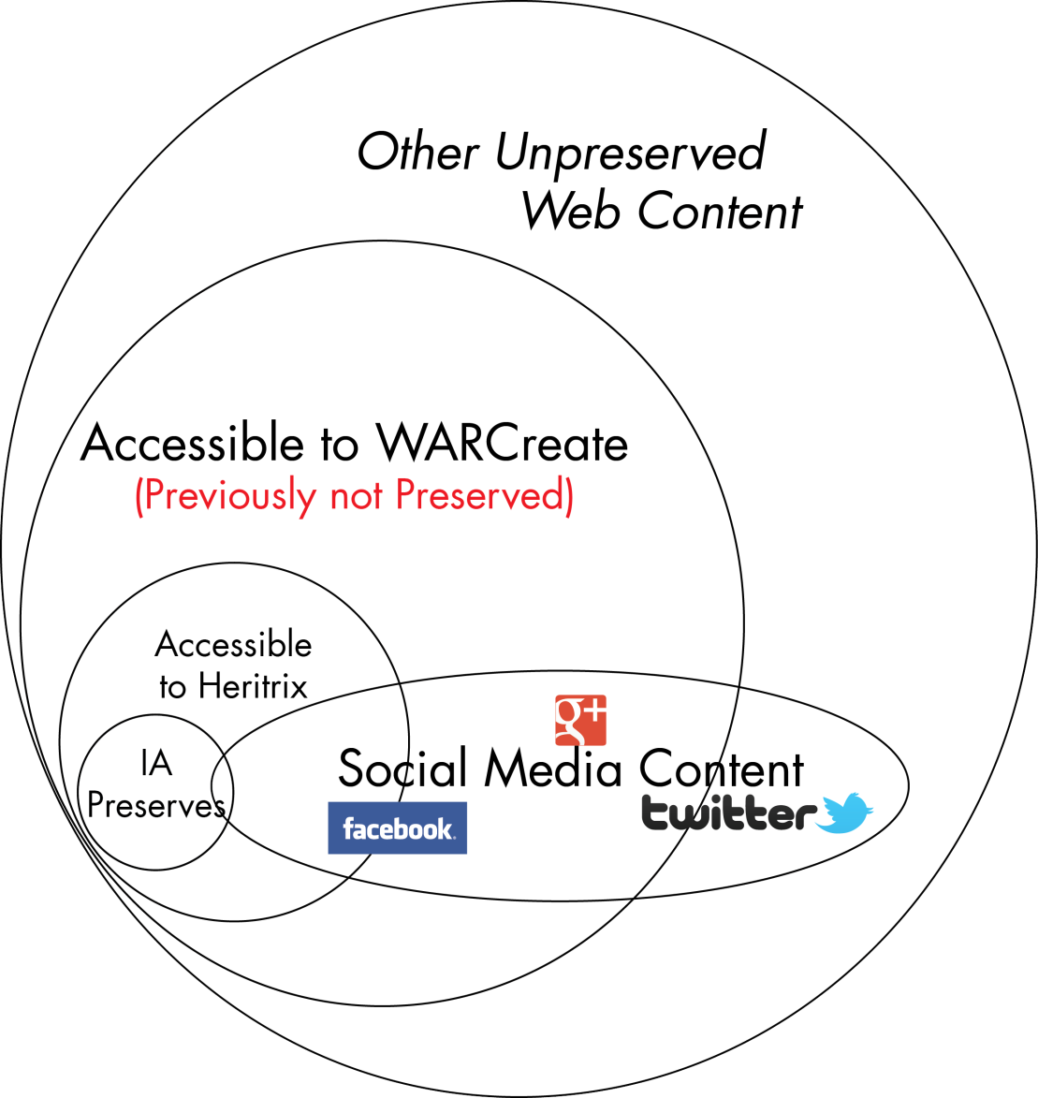
Capture Scope
Not limited to robots.txt
Native JS Support (from browser)
User accessible
No URI delegation

Slide 33
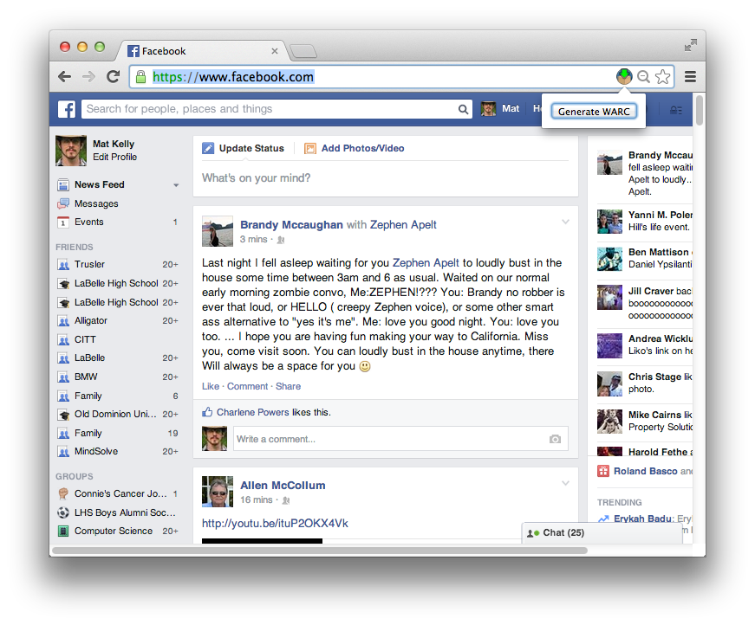
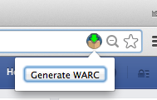
User Dynamics
Simple operation: navigate, click a button
Files downloaded with smart defaults to HDD

Slide 34
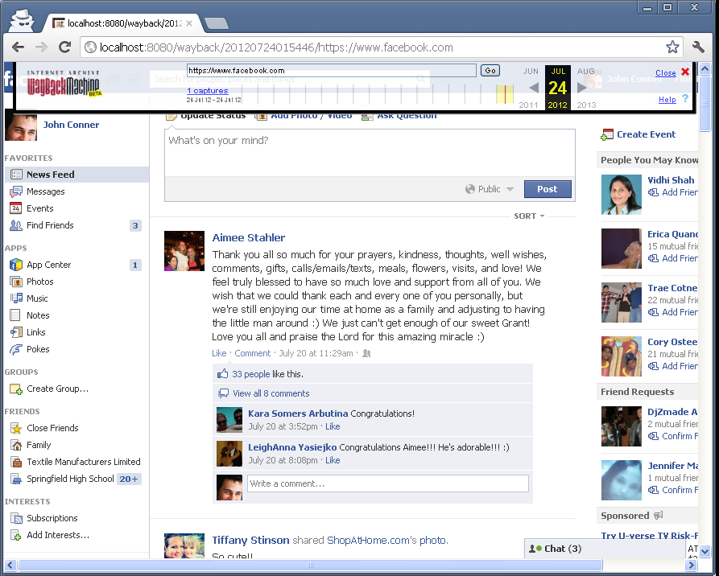
Caveats of Personal Web Archiving
We may not want our personal info in archives
Your http://facebook.com and mine are vastly different
…but same URI!
Even if we capture it, it might not be replayable
Limited by replay system

Slide 35
Recent Work/Outstanding Issues
Direct upload of WARC to server
Comprehensive Site Archiving (e.g., all your )
Annotation of Web Pages
Grouping WARCs into archival collections
Periodic, automated execution
Portable JS WARC interaction library
Much more!

Slide 36
But…Isn’t This Just Coding and Not Research?
WARC work in the JS space is non-existent!
Initial implementations have already uncovered limitations
JS tech has evolved, opened new doors for functionality
WARCreate is state-of-the art for using JavaScript/Browsers FOR archiving

Slide 37
Browser-Based Digital Preservation WARCreate as Research
Publications
Mat Kelly and Michele C. Weigle, "WARCreate - Create Wayback-Consumable WARC Files from Any Webpage," In Proceedings of the ACM/IEEE Joint Conference on Digital Libraries (JCDL). Washington, DC, June 2012, pp. 437-438
Mat Kelly, Michele C. Weigle and Michael L. Nelson. "WARCreate - Create Wayback-Consumable WARC Files from Any Webpage," Digital Preservation 2012, Tools Demo Session: Web Archiving; 2012 Jul 25; Washington, DC.
Mat Kelly, Michael L. Nelson and Michele C. Weigle. "WARCreate and WAIL: WARC, Wayback and Heritrix Made Easy," Digital Preservation 2013, Workshops and Sessions: Web Archiving; 2013 Jul 24; Alexandria, VA
Academic Funding
Archive What I See Now: Bringing Institutional Web Archiving Tools to the Individual Researcher, National Endowment for the Humanities (NEH), Digital Humanities Start-Up Grant, HD-51670-13, May 2013 - Dec 2014, $57,892
Notoriety
Future Steward Innovation Award Recipient, National Digital Stewardship Alliance (NDSA) / Library of Congress, July 2012

Slide 38
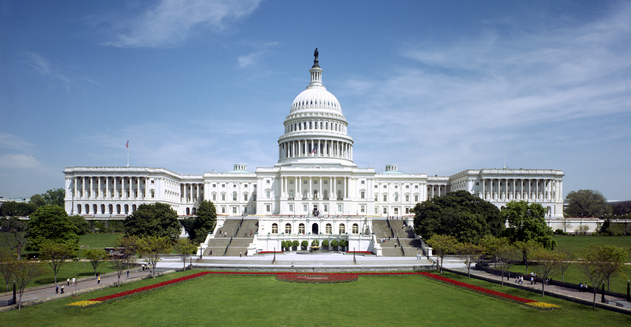
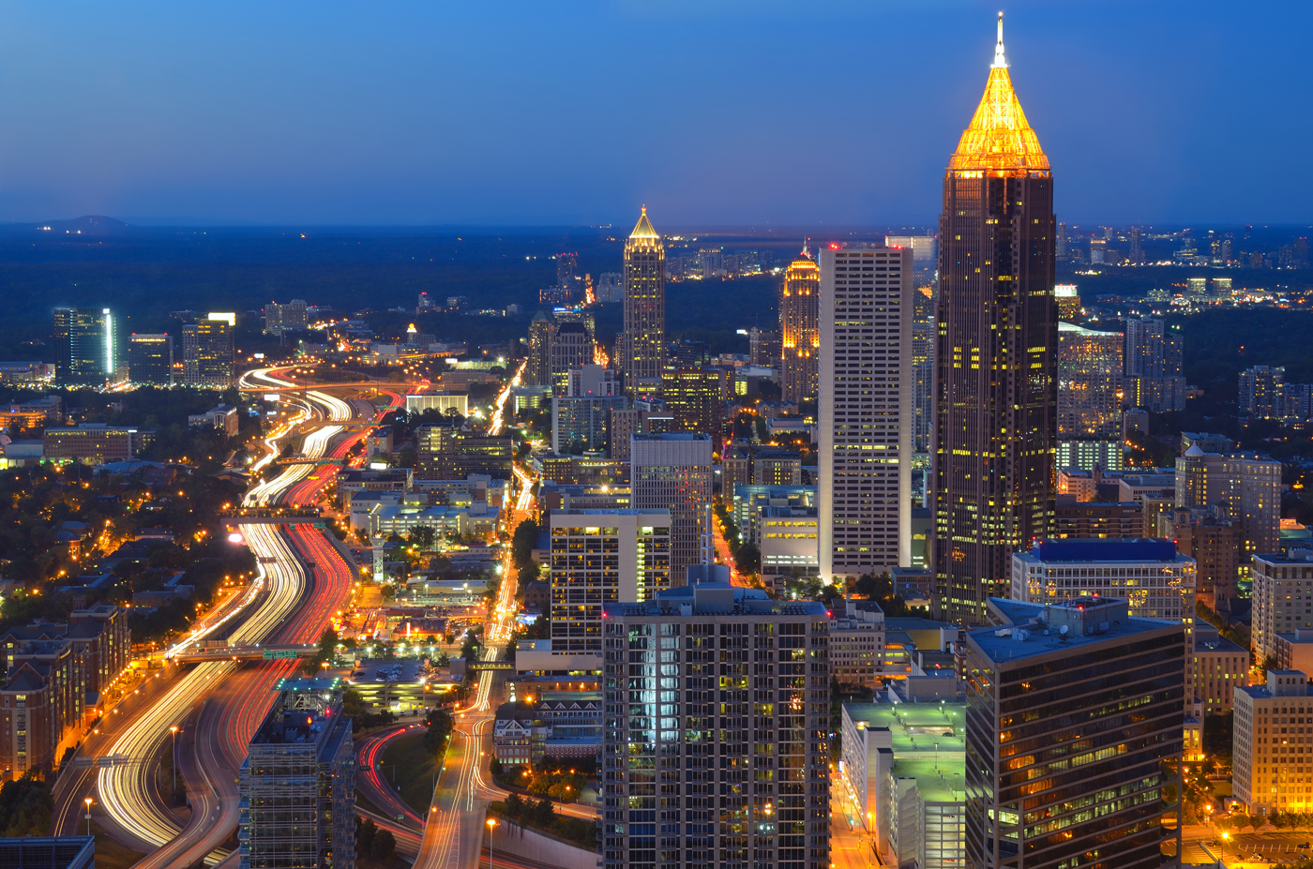
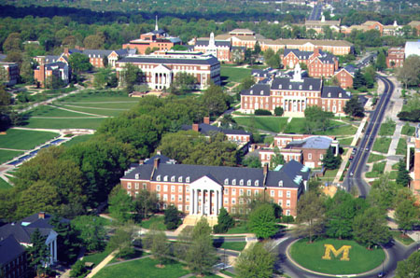
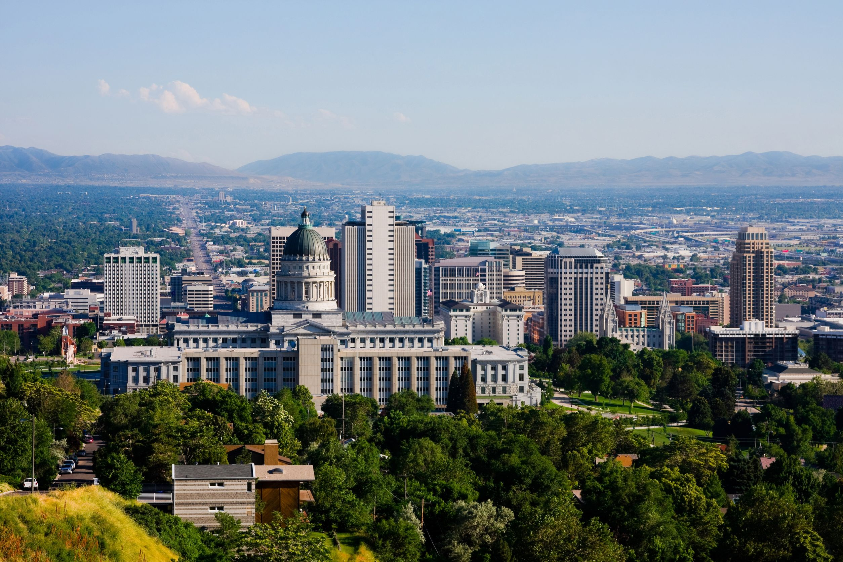
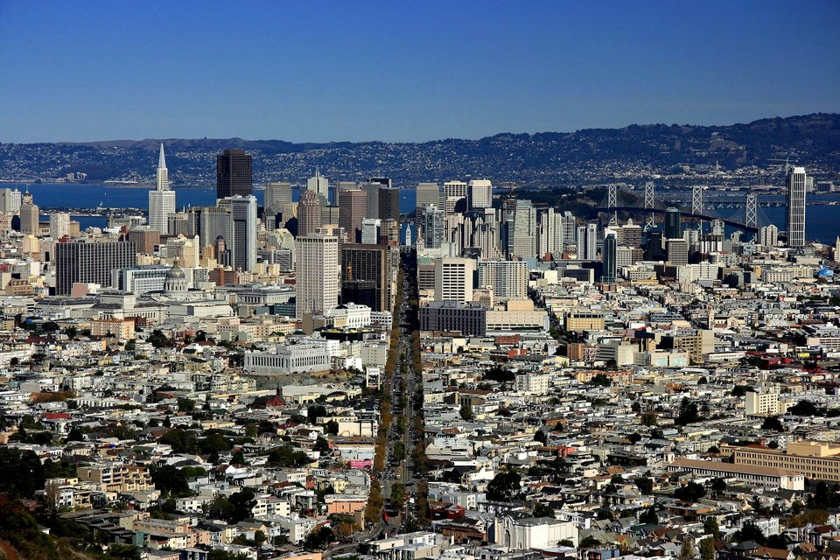
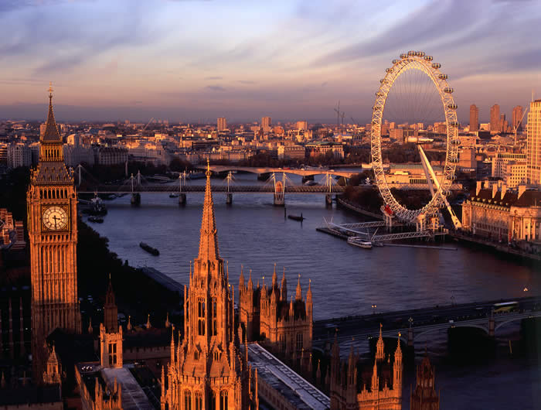
Where I Have Traveled as a ODU Researcher
Washington, DC
Atlanta, GA
College Park, MD
…
Salt Lake City, UT
San Francisco, CA
London, England
(Sept 2014)

Slide 39
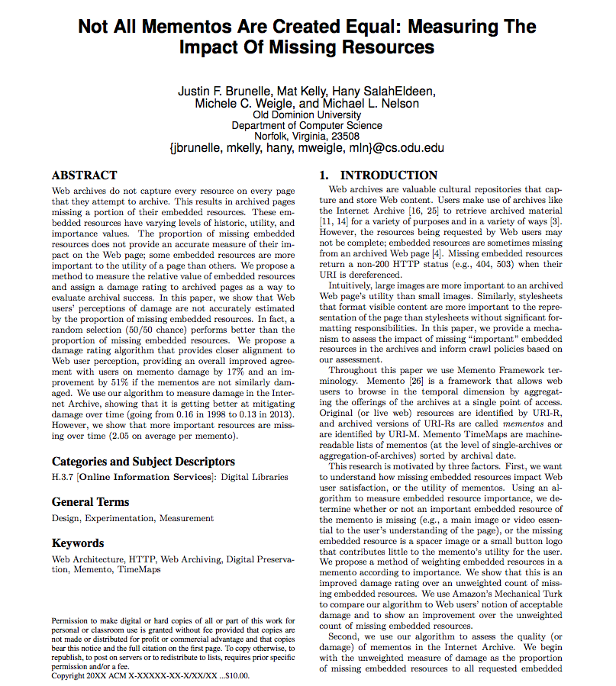
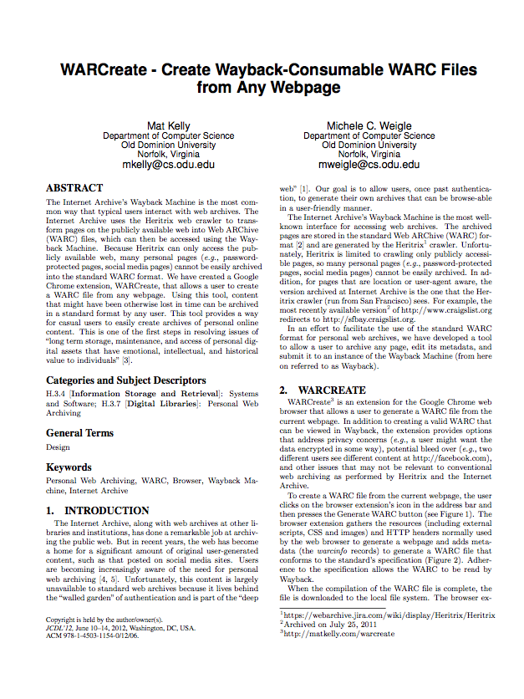
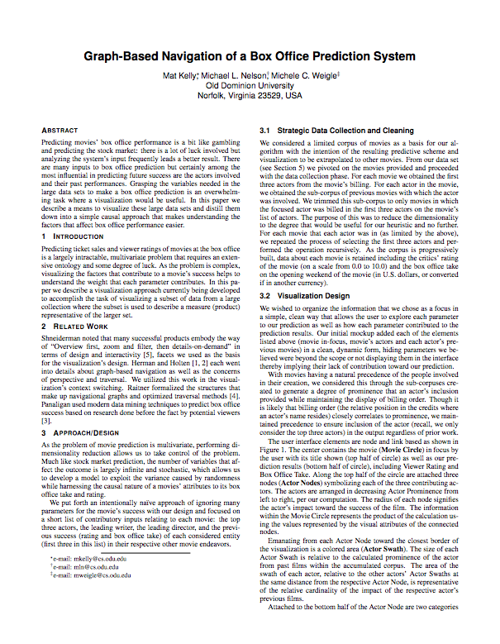
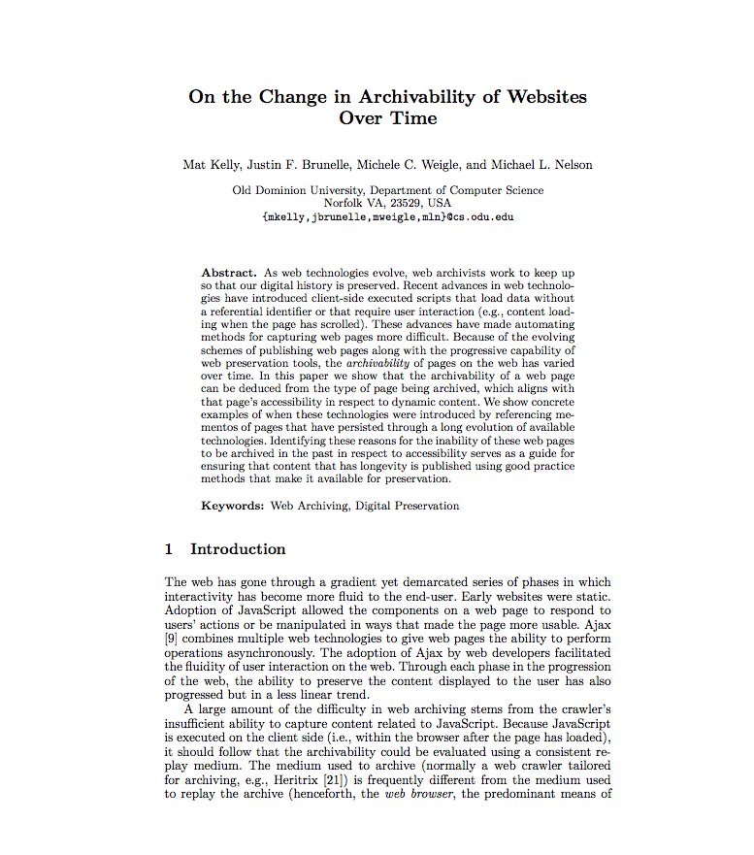
Browser-Based Digital Preservation
→Publications
Travel←
→Notoriety
Academic
Funding
←

