Slide 1
Visualizing Digital Collections of Web Archives
Mat Kelly, Michael L. Nelson, Michele C. Weigle
Old Dominion University
Web Archiving Collaboration: New Tools and Models
Columbia University, New York, NY
June 4, 2015
http://ws-dl.cs.odu.edu
@machawk1

Slide 2
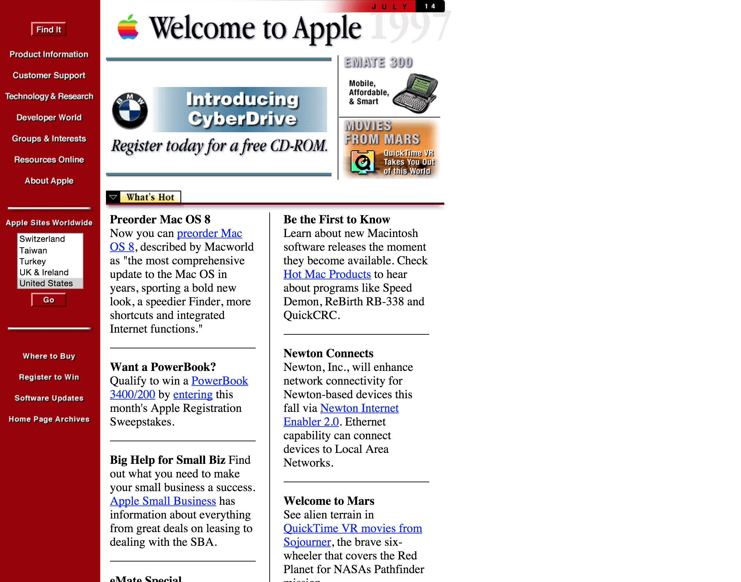
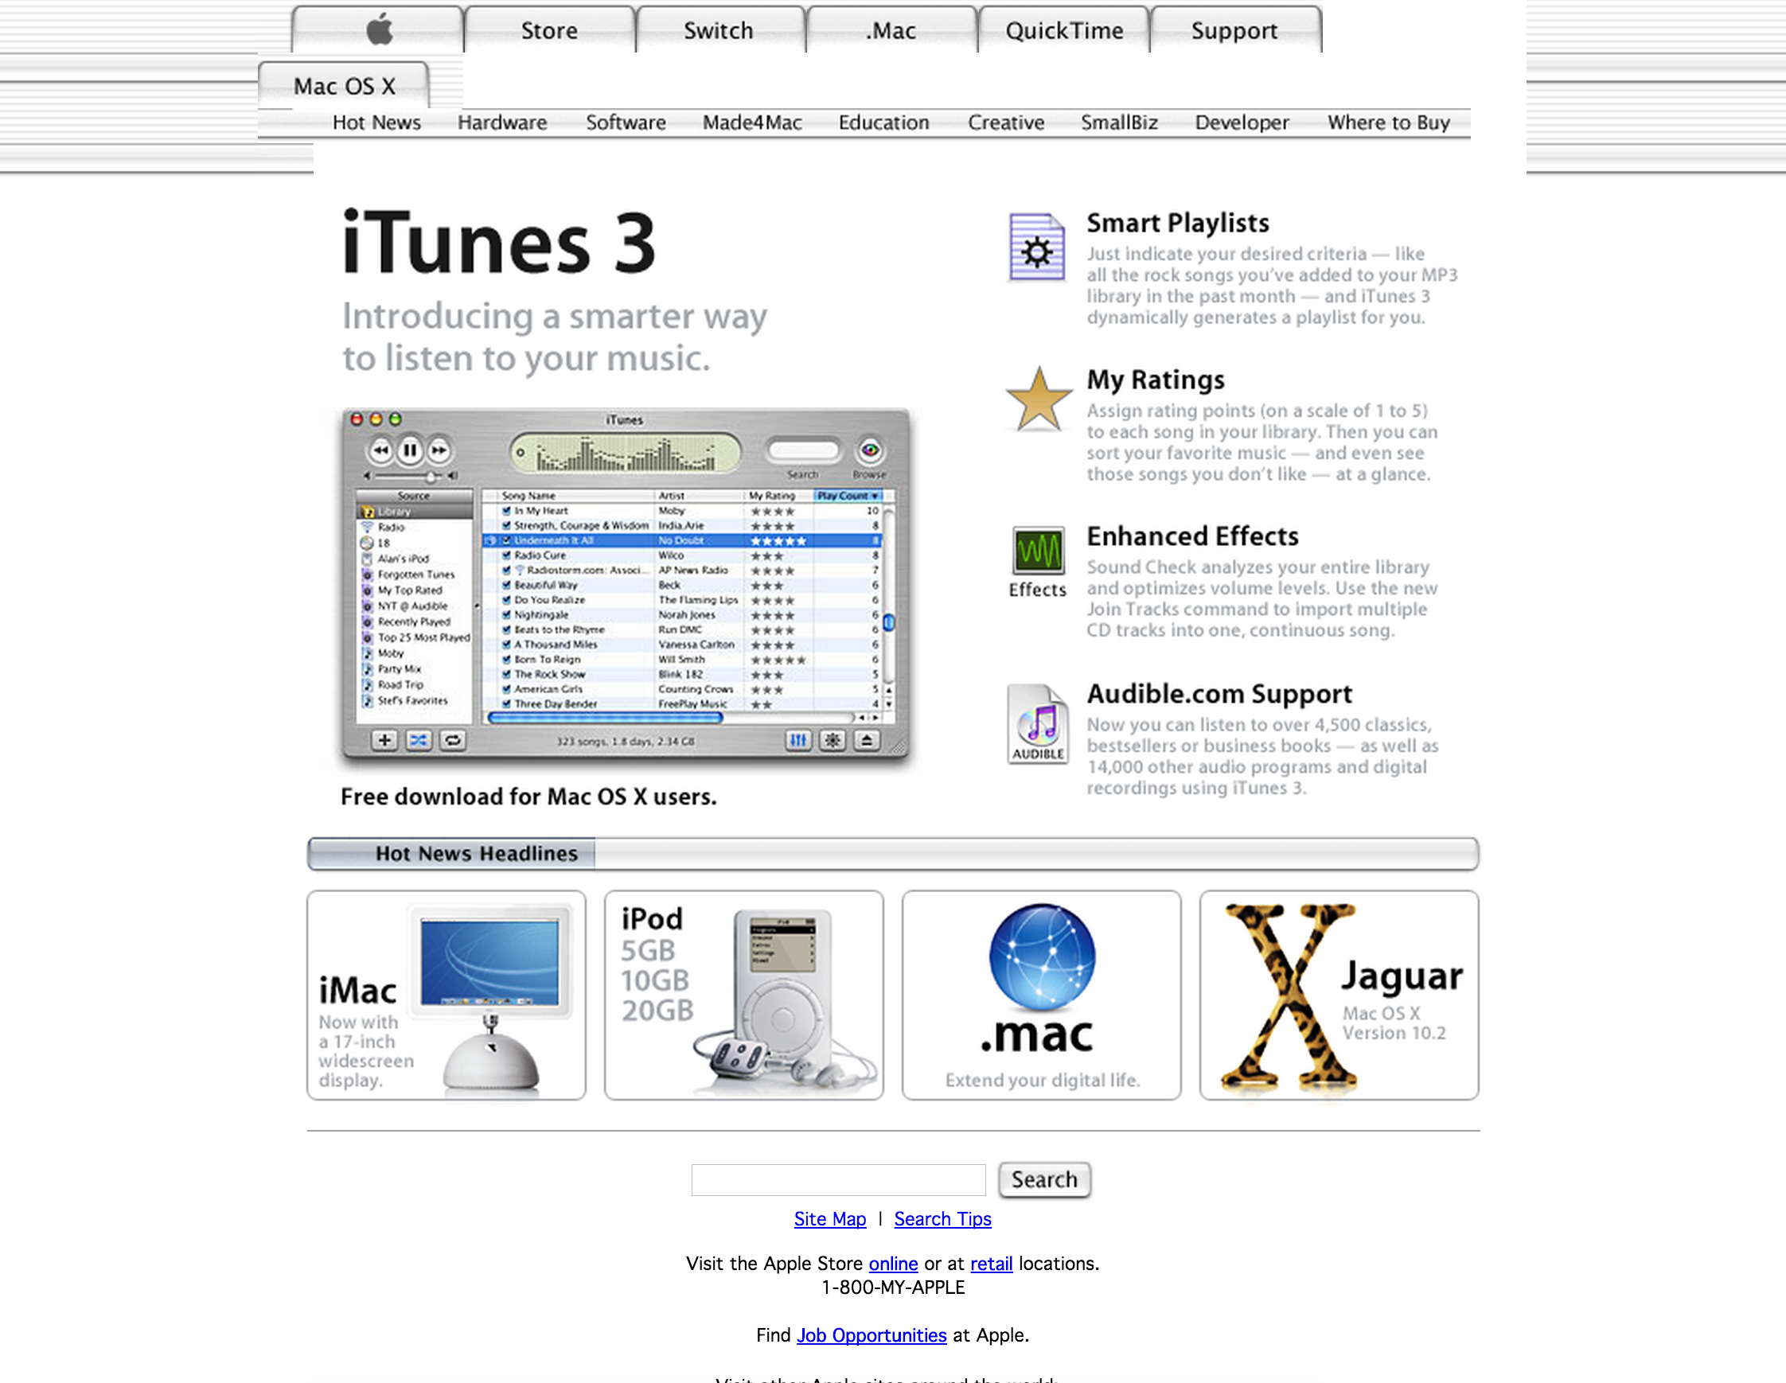
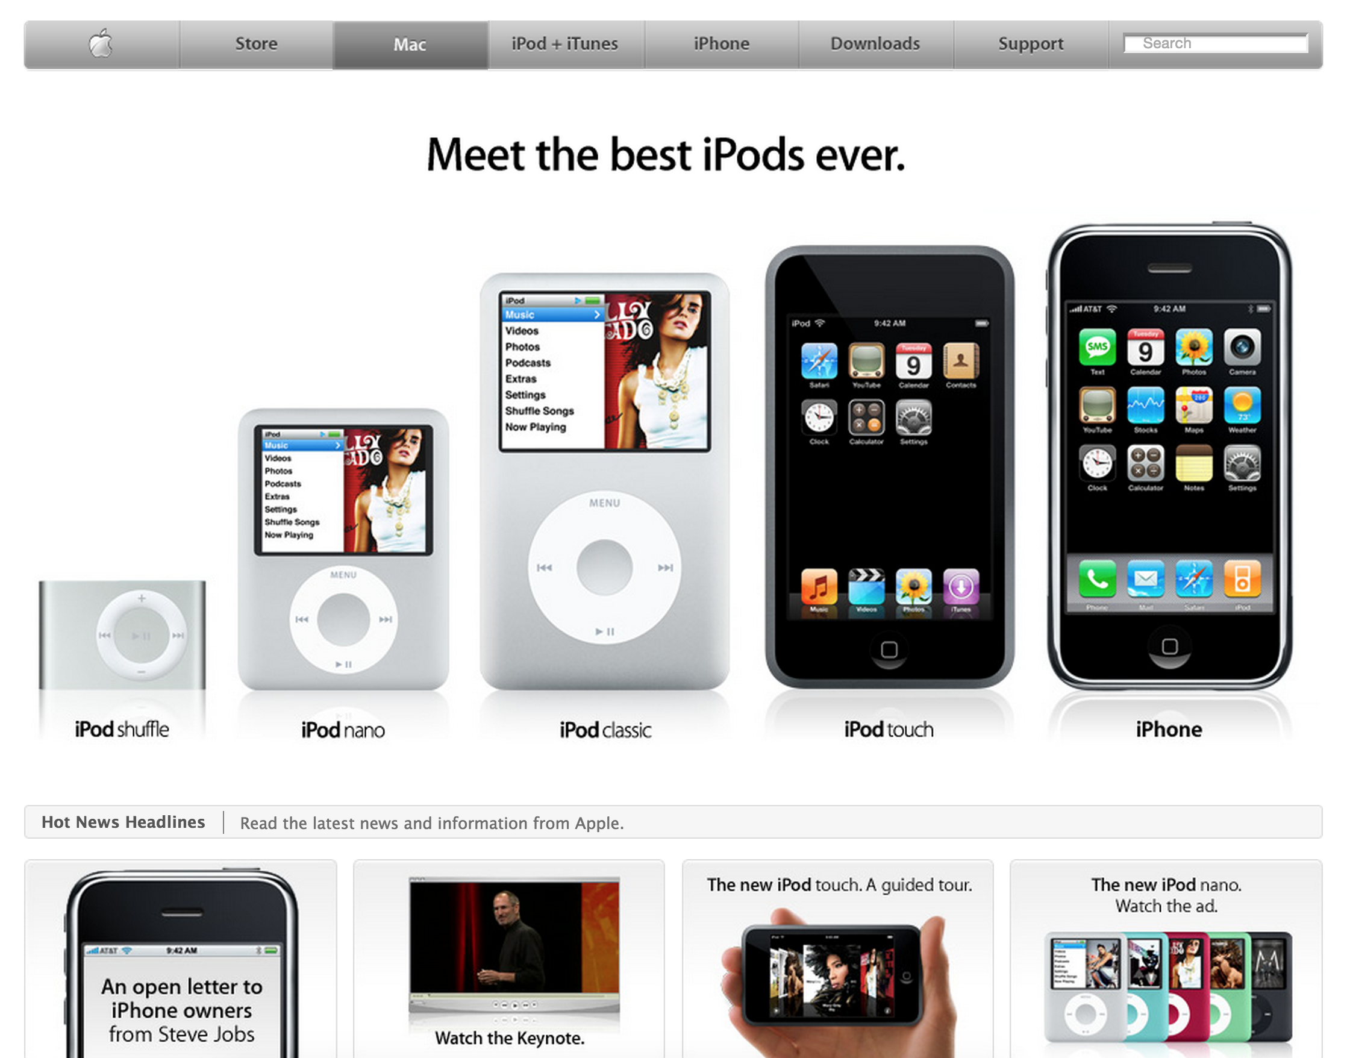
Motivation for Thumbnail Summarization
Change over time - aboutness

Slide 3
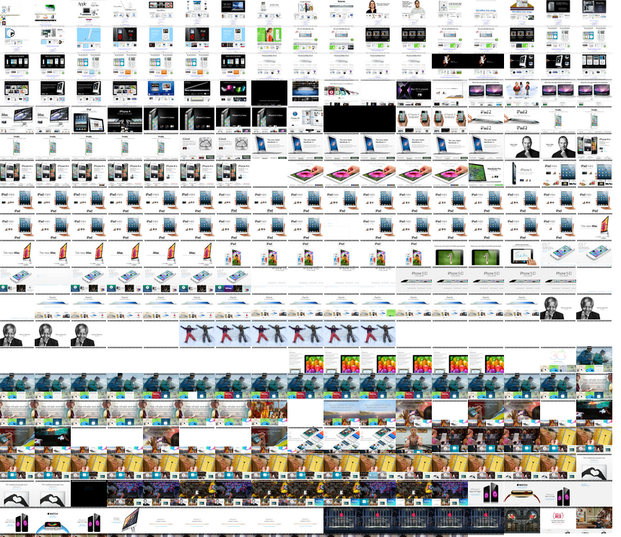
Apple.com has > 17k mementos

Slide 4
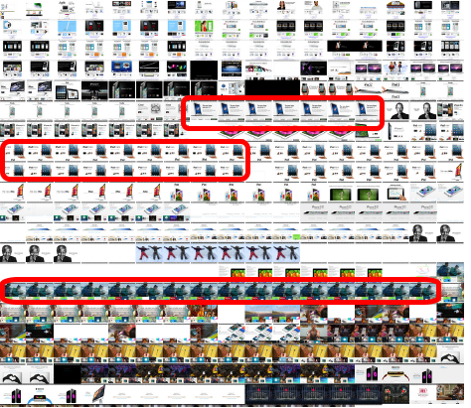
Many Nearly Identical (apple.com)

Slide 5
Methods of Summarization
Including all mementos
many redundant thumbnails
temporally/spatially/cognitively expensive
Naively excluding images
missing important captures in summary
Compare image thumbnails
temporally expensive for identifying unique thumbnails
Comparing mementos’ markup can identify sufficiently unique mementos

Slide 6
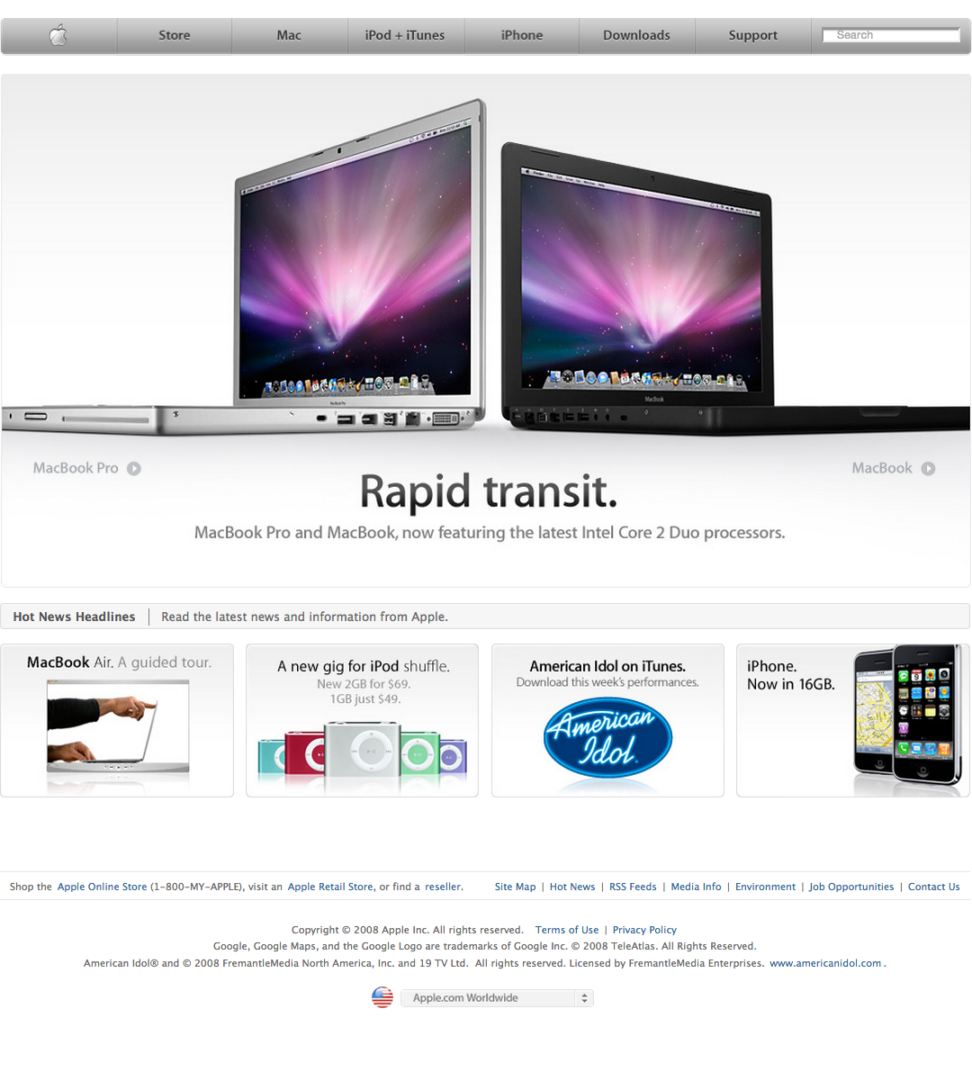
Analyzing Markup
<title>Apple</title>
<meta property="analytics-track" content="Apple - Index/Tab" />
<meta property="analytics-s-channel" content="homepage" />
<meta property="analytics-s-bucket-0" content="appleglobal,applehome" />
<meta property="analytics-s-bucket-1" content="apple{COUNTRY_CODE}global,apple{COUNTRY_CODE}home" />
8664ee964799c38c156d8f039dae8330
apple.com at Mar 17, 2008
HTML for memento
SimHash for HTML

Slide 7
SimHash?
HTML snippet for memento
First k characters of markup
Hash to a character
c
3
Second k characters of markup
Hash to a character
…
…
63rd k characters of markup
Hash to a character
9
f
64th k characters of markup
Hash to a character
k =
markup length
64

Slide 8
SimHash vs. Other Hashes
md5(“aaaaaaaaaaaaaaa”)
➔12f9cf6998d52dbe773b06f848bb3608
md5(“aaaaaaabaaaaaaa”)
➔e984cee68697eb77577717b532171493
simhash(“aaaaaaaaaaaaaaa”)
➔8664ee964799c38c156d8f039dae8330
simhash(“aaaaaaabaaaaaaa”)
➔8664ee964799a48c156d8f039dae8330

Slide 9
Why SimHash?
SimHash identifies similarities between documents
Conventional hashing algorithms are for identifying differences
Drastically different output from similar content
To remove redundancies, we want to detect when temporally adjacent mementos are sufficiently dissimilar

Slide 10
SimHashes for Mementos
HTML of apple.com
March 3, 2008
c39f0abc...b9
HTML of apple.com
March 5, 2008
c39d0abc...c9
HTML of apple.com
April 12, 2008
c39d0abc...b9
HTML of apple.com
October 4, 2008
c770ad1b...b9

Slide 11
Identifying Similarity by Calculating Hamming Distance
HAMMING DISTANCE
HTML of apple.com
March 3, 2008
c39f0abc...b9
N/A
pivot
HTML of apple.com
March 5, 2008
c39d0abc...c9
2
HTML of apple.com
April 12, 2008
c39d0abc...b9
1
HTML of apple.com
October 4, 2008
c770ad1b...b9
7

Slide 12
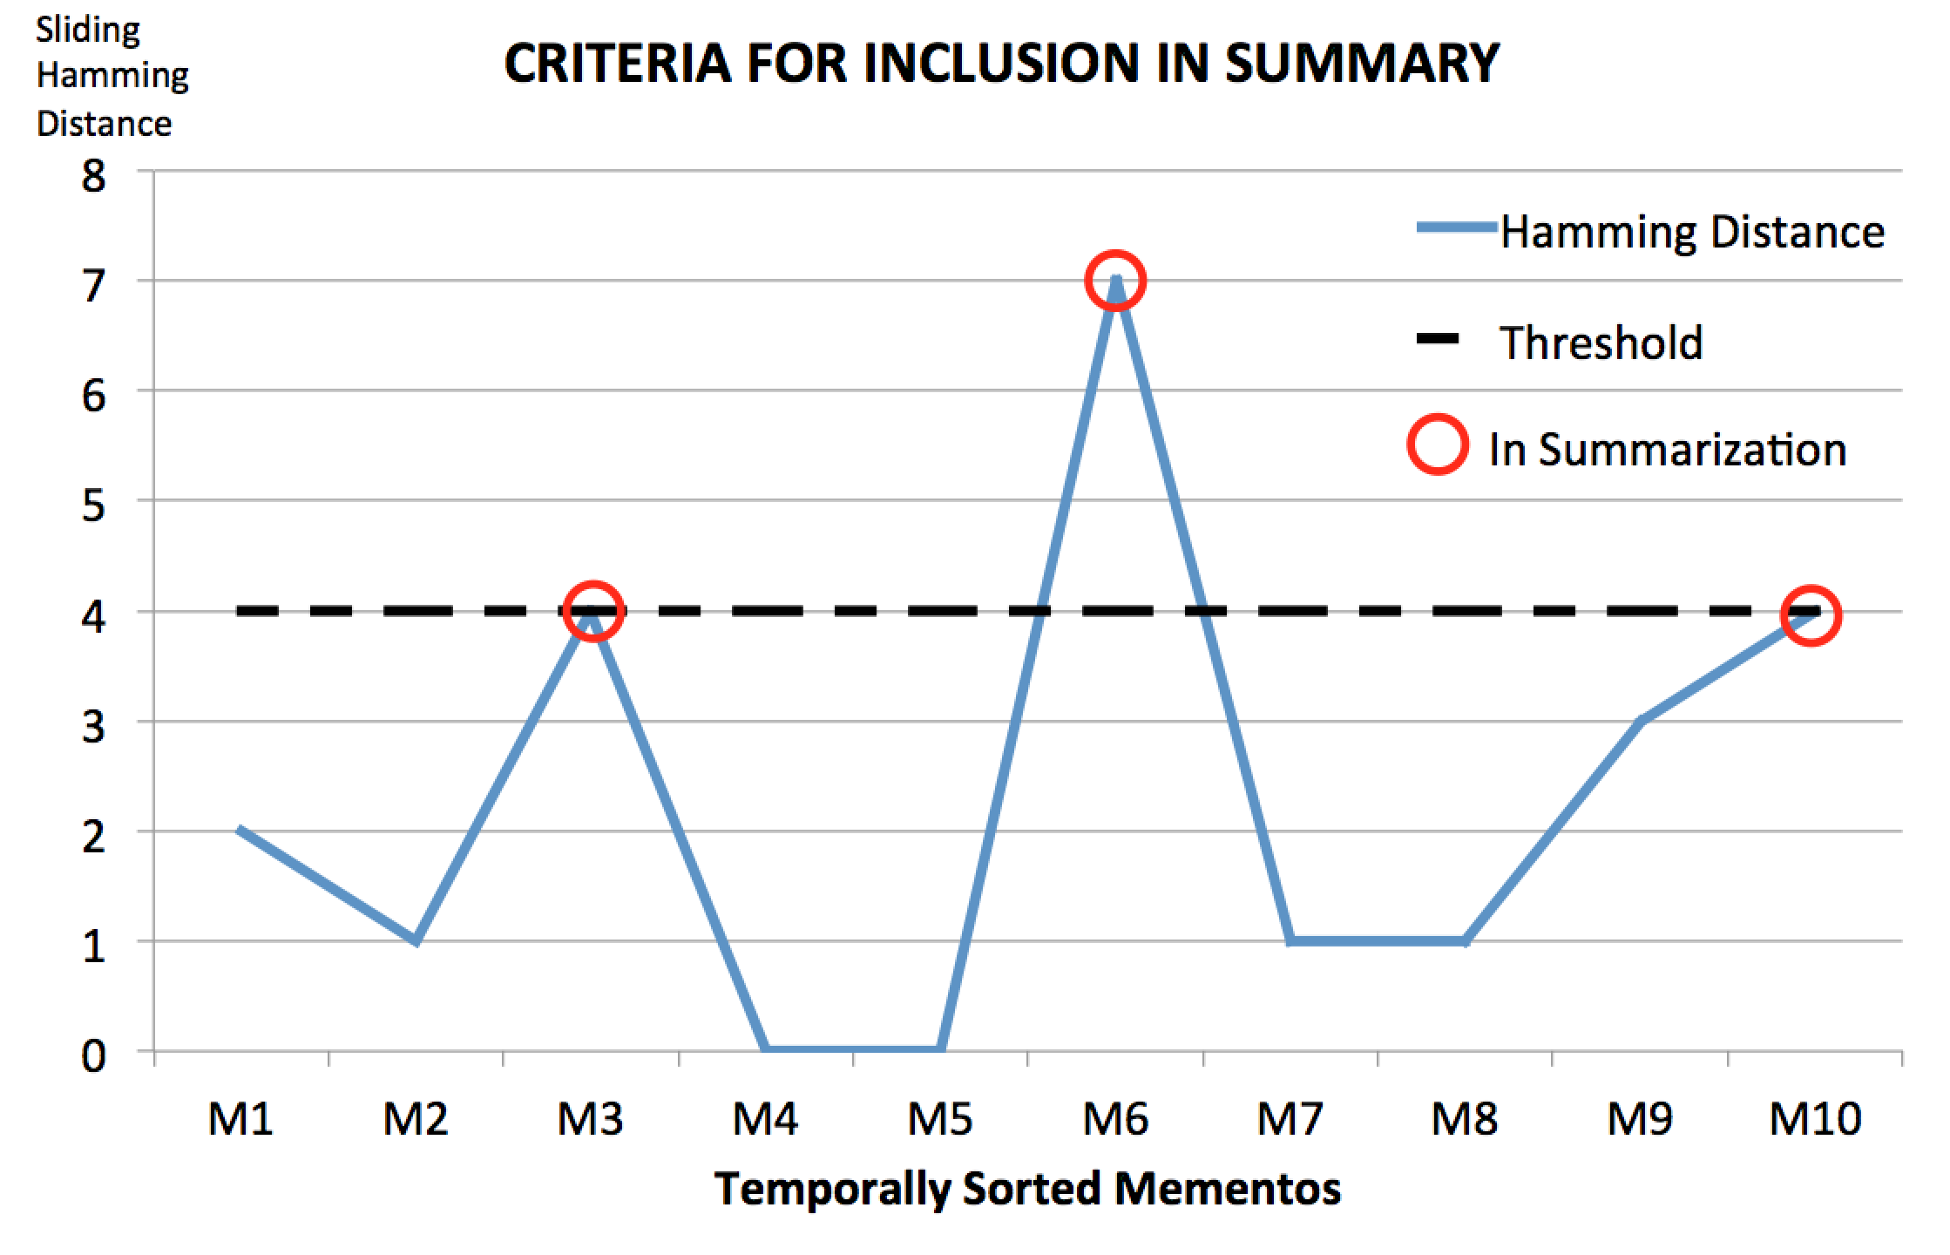
In Summarization

Slide 13
Sliding Hamming Distance
Selection based on previously selected memento
Sliding pivot
ΔM3
ΔM0
ΔM0
ΔM6
ΔM6
ΔM6
ΔM0
ΔM3
ΔM3
ΔM6

Slide 14
Project Goals
Develop tools that implement thumbnail summarization for TimeMaps
Web Service
Allows anyone to view TimeMap using thumbnail summarization
Wayback add-on
Allows any archive using wayback to provide this service to users
Embeddable version
Allow web page authors to embed overview of past versions of page on live web page

Slide 15
AlSummarization
SimHash-based summarization scheme created by Ahmed AlSum
AlSum + Summarization = AlSummarization
A. AlSum, and M. L. Nelson. “Thumbnail Summarization Techniques for Web Archives.” In Proceedings of the 36TH European Conference on Information Retrieval, ECIR 2014, 2014.

Slide 16
Dr. Nelson’s Homepage
URI-R: http://www.cs.odu.edu/~mln
Append onto service URI for summary
http://service/http://www.cs.odu.edu/~mln

Slide 17
Anatomy of the Visualization
Temporally sorted
mementos
Memento metadata
3 presentations of the Summary

Slide 18
Additional (optional) Endpoint Parameters
Access – tailors user interface
Interactive, Embed, Wayback
Strategy – to use alternative summarization
alSummarization, yearly, skipListed, random
http://service/?
access=wayback&URI-R=http://www.cs.odu.edu/~mln
access=wayback&strategy=random&URI-R=http://www.cs.odu.edu/~mln

Slide 19
Programmatic Flow
User’s Browser
Thumbnails
Service
Memento-Compliant
Archive

Slide 20
User Requests URI-R Summary
User’s Browser
Thumbnails
Service
Memento-Compliant
Archive

Slide 21
Service Relays URI-R to Archive
User’s Browser
Thumbnails
Service
Memento-Compliant
Archive
Service queries archive for all mementos for URI-R

Slide 22
URI-Ms returned to Service
TM
User’s Browser
Thumbnails
Service
Memento-Compliant
Archive
Archive returns TimeMap with URI-Ms to thumbnail service

Slide 23
Service fetches HTML for each Memento
Thumbnails
Service

Slide 24
Service generates SimHash for Each Mementos’ HTML
c39f0abc...b9
c39d0abc...c9
c39d0abc...b9
c770ad1b...b9
c770ad1b...b9
Thumbnails
Service

Slide 25
Service Calculates Hamming Distance
Hd()
c39f0abc...b9
2
c39d0abc...c9
1
c39d0abc...b9
7
c770ad1b...b9
0
c770ad1b...b9
Thumbnails
Service
Mementos in summary selected based on hamming distance

Slide 26
Preliminary UI returned to user
HTML
interface
User’s Browser
Thumbnails
Service
Templated HTML interface is returned to user with placeholders for thumbnails

Slide 27
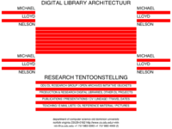
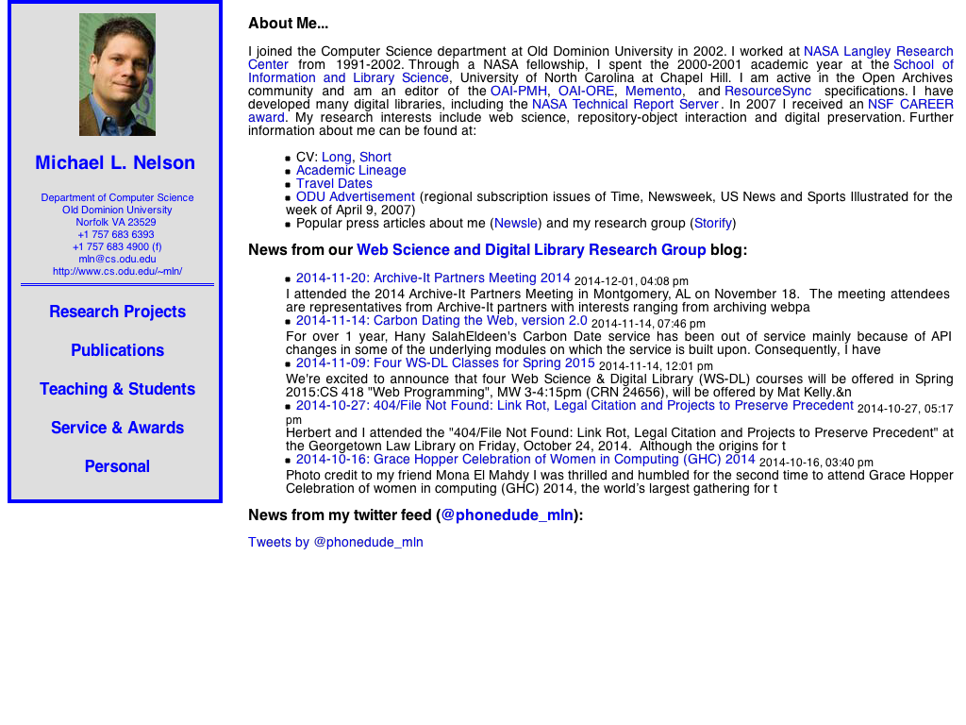
Service Generates Thumbnails for Mementos in Summary
Hd()
c39f0abc...b9
2
c39d0abc...c9
1
c39d0abc...b9
7
c770ad1b...b9
0
c770ad1b...b9
Thumbnails
Service

Slide 28
Thumbnails Served to User
HTML
interface
User’s Browser
Thumbnails
Service
Asynchronous polling from HTML pages populates placeholder images once available

Slide 29
Core Implementation
for thumbnail generation
abstractions preserved for code reuse and extensibility
Code documented to facilitate extensibility, usage, and fixes
http://github.com/machawk1/ArchiveThumbnails

Slide 30
Initializing the service
User/Service Administrator simply enters:
$ npm install
$ node alSummarization.js
Service responds and is ready for query:
* Local resource (css, js,etc.) server listening on Port 1338...
* Thumbnails service started on Port 15421
> Try localhost:15421/?URI-R=http://matkelly.com in your web browser for sample execution.

Slide 31
Online vs. Offline Generation
Online Thumbnail Summarization
Fetch each mementos’ HTML
Calculate SimHashes
Calculate Hamming Distance (HD)
Select Mementos That Pass HD threshold
Generate Thumbnails of Mementos
Offline Thumbnail Summarization
All of the above performed a priori
Data potentially updated on access

Slide 32
Adaptive Strategies
Very large TimeMaps are temporally expensive to generate
Default behavior:
if(timeRequirement == tooLong):
use(naiveStrategy)
User can explicitly override behavior

Slide 33
Other Summarization Strategies
Random Selection
k mementos, uniform selection
Interval
every m^{th} memento, m = ^{n}/_{k}
Temporal Interval
One memento/year, reverse chronological monthly back-fill
Temporally Uniform Trimming when k > 15

Slide 34
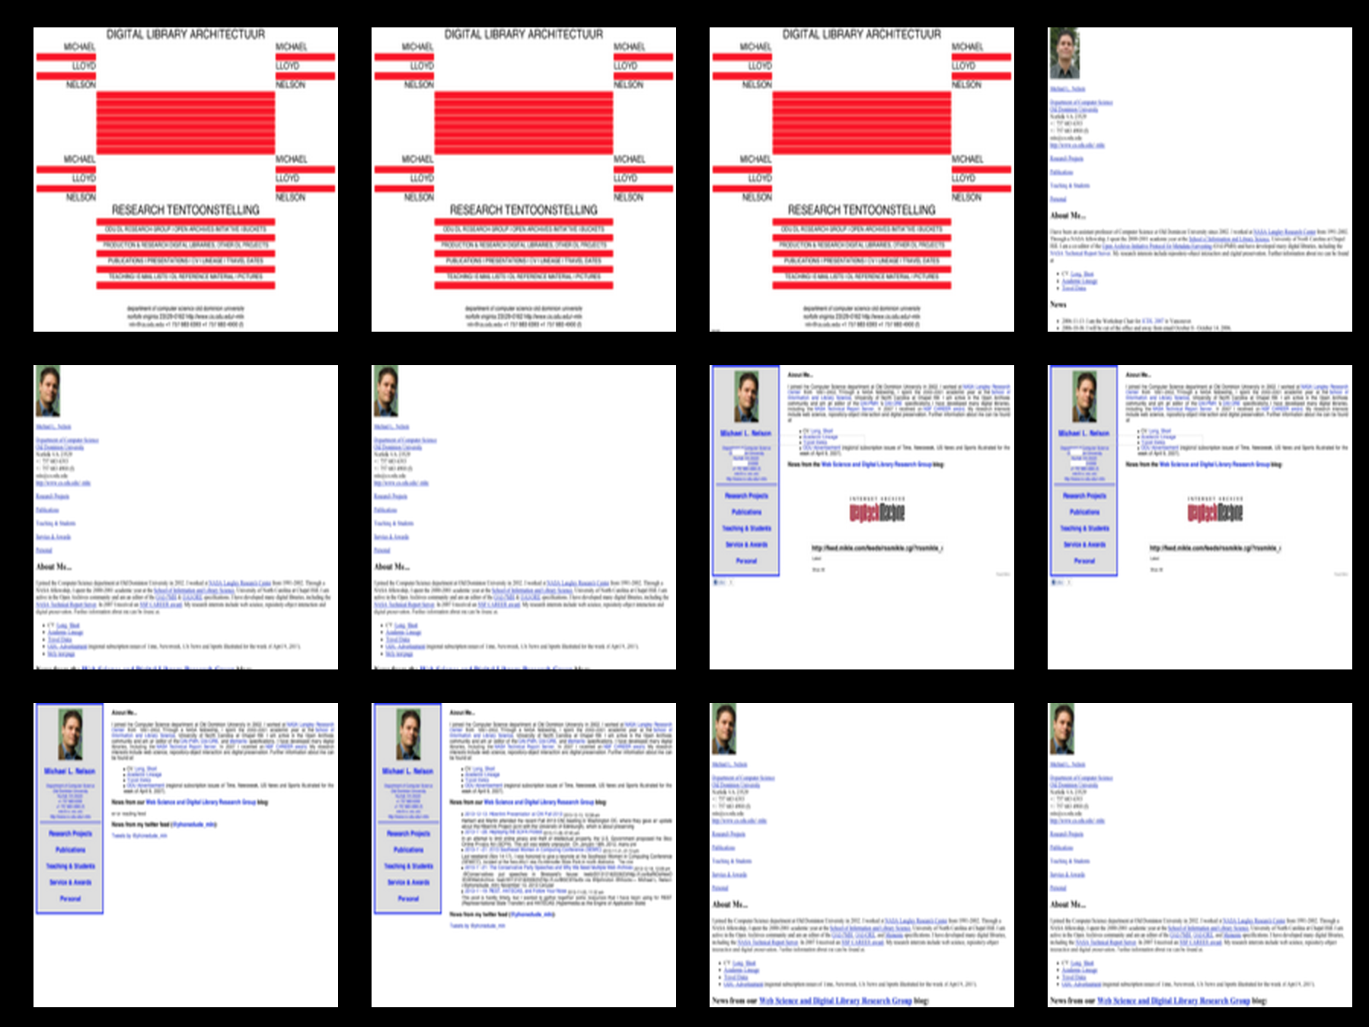
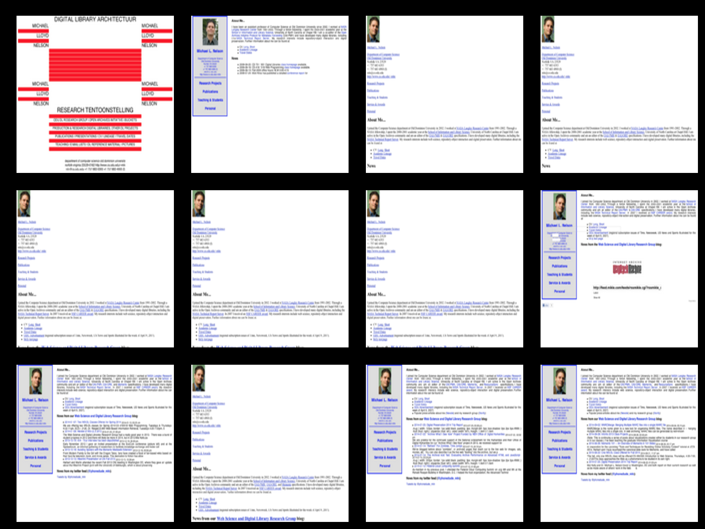
Grid View AlSummarization vs Random
Dr. Nelson’s Homepage
Random Strategy
Dr. Nelson’s Homepage
AlSummarization Strategy

Slide 35
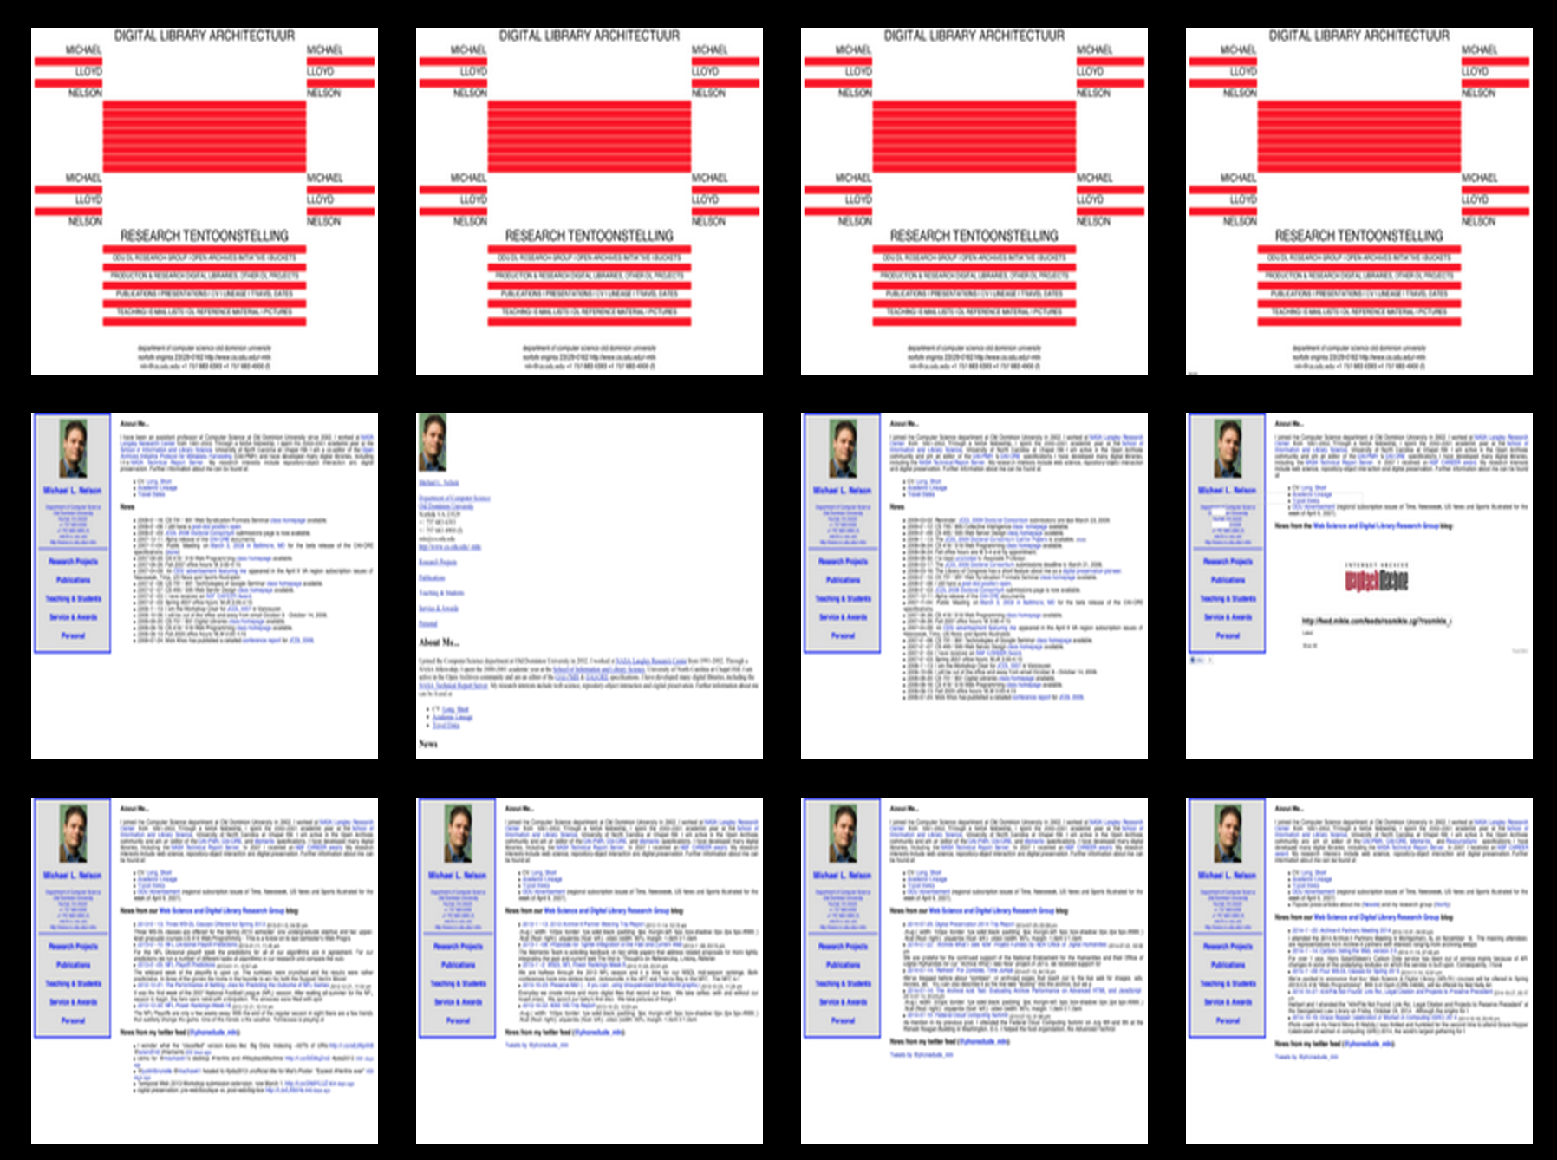
Grid View AlSummarization vs Interval
Dr. Nelson’s Homepage
Interval Strategy
Dr. Nelson’s Homepage
AlSummarization Strategy

Slide 36
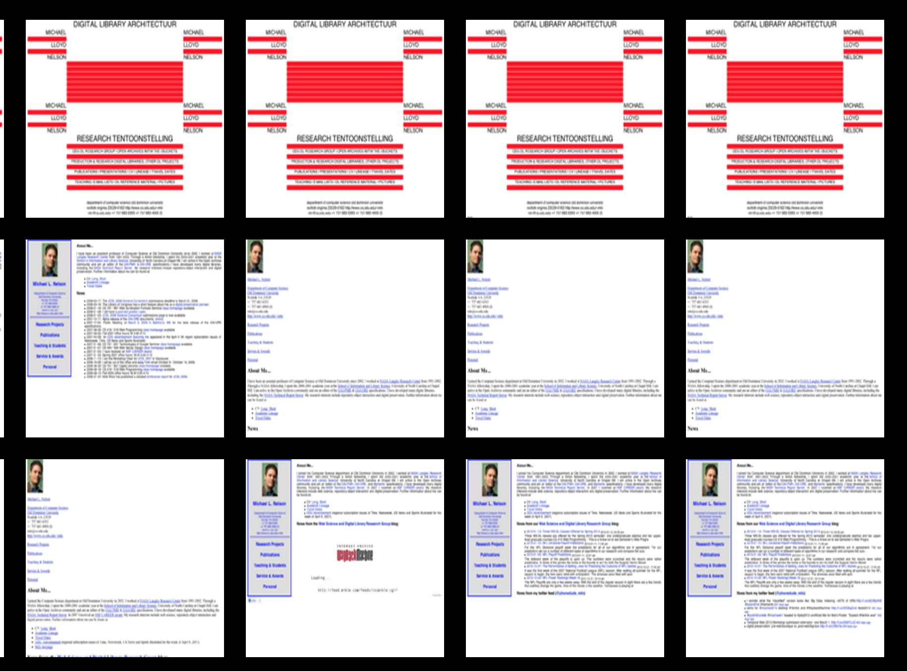
Grid View AlSummarization vs Temporal Interval
Dr. Nelson’s Homepage
Temporal Interval Strategy
Dr. Nelson’s Homepage
AlSummarization Strategy

Slide 37
Asynchronous Polling

Slide 38
Server-side SimHash Caching

Slide 39
Four Summarization Strategies

Slide 40
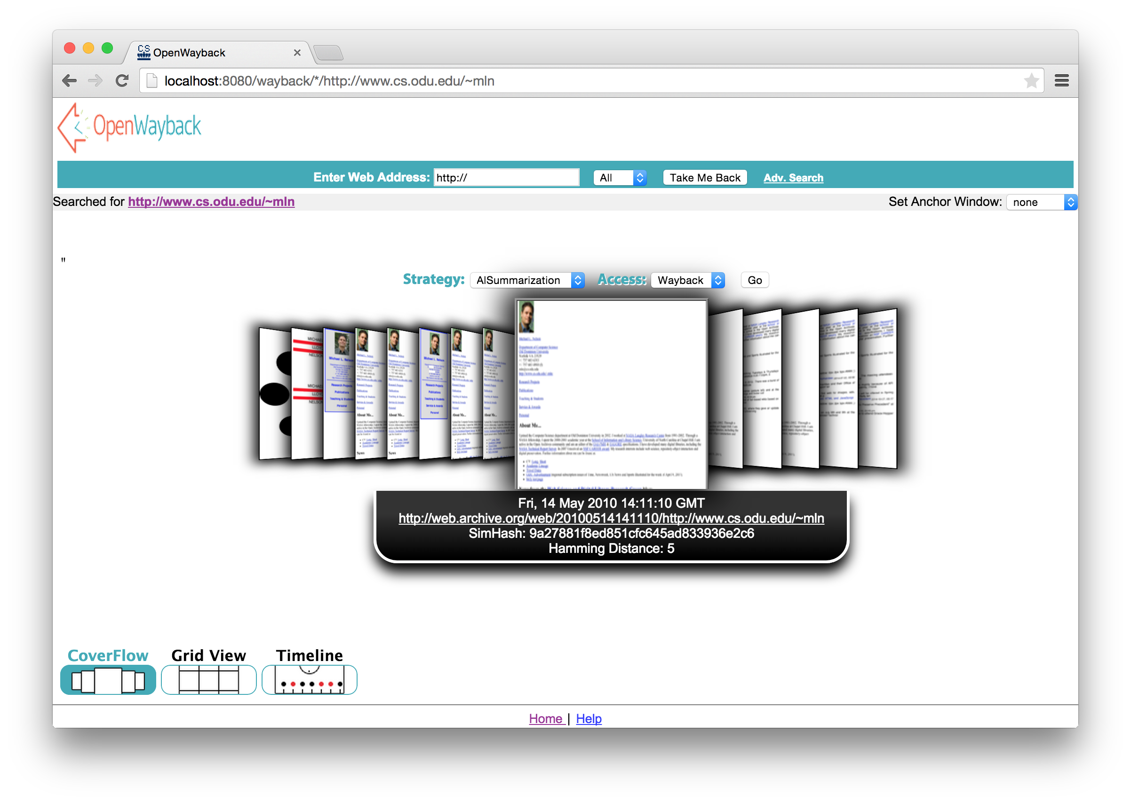
OpenWayback Integration

Slide 41
Service Embedding
<object data=http://service/http://yoururl.com” type=“text/html”> </object>
-or-
<iframe src=“http://service/http://yoururl.com”> </iframe>

Slide 42
Visualizing Digital Collections of Web Archives
Codebase:
github.com/machawk1/ArchiveThumbnails
Service URI:
http://wsdl-docker.cs.odu.edu:15421

Slide 43
Live
Demo

