Slide 1
A Computational approach to historical ontologies
Archival resource key persistent identifiers for terms
Computational Archival Science (CAS) Workshop
IEEE BigData 2020
December 12, 2020

Slide 2
Mat Kelly Assistant Professor, Information Science College of Computing and Informatics Drexel University mkelly@drexel.edu | Jane Greenberg Alice B. Kroeger Professor and Director, Metadata Research Center College of Computing and Informatics Drexel University jg3243@drexel.edu
Christopher Rauch College of Computing and Informatics Research Assistant at CCI Drexel University cr625@drexel.edu | Sam Grabus Research Assistant, MRC LEADING Project Manager College of Computing and Informatics Drexel University smg383@drexel.edu
Joan Boone Senior Research Analyst and Instructor College of Computing and Informatics Drexel University jpb357@drexel.edu
Peter Logan Professor Emeritus and Director of Digital Scholarship Center Temple University peter.logan@temple.edu | John Kunze Identifier Systems Architect California Digital Library University of California, Berkeley jak@ucop.edu

Slide 3
Why historical ontologies ?
CC BY-SA 3.0, via Wikimedia Commons

Slide 4
Library of congress subject headings
Source: Pascua, Greenberg, Logan, Boone NKOS 2019

Slide 5
What is an ark?
CC BY-SA 3.0 Dorin Coltofeanu via Wikimedia Commons

Slide 6
What’s the difference?
“[P]ersistence is purely a matter of service and is neither inherent in an object nor conferred on it by a particular naming syntax.”
Kunze, 2020, IETF Draft Standard

Slide 7
Ark format

Slide 8
Minting arks
noid - nice opaque identifier generator
$ noid dbcreate b4.reedeedk long 99152 cci.drexel.edu mrc/lcsh
Created: minter for 70728100 random identifiers of form b4.reedeedk
A Noid minting and binding database has been created that will bind
and mint 70,728,100 identifiers with the template "b4.reedeedk".
Sample identifiers would be "99152/b49h36s6c" and "99152/b4gs3nk3x".
Minting order is random. See ./NOID/README for details.
$ noid mint 5
id: 99152/b44x54g1f
id: 99152/b4154dn70
id: 99152/b4wd3q121
id: 99152/b4rn3068n
id: 99152/b4mw28d4h

Slide 9
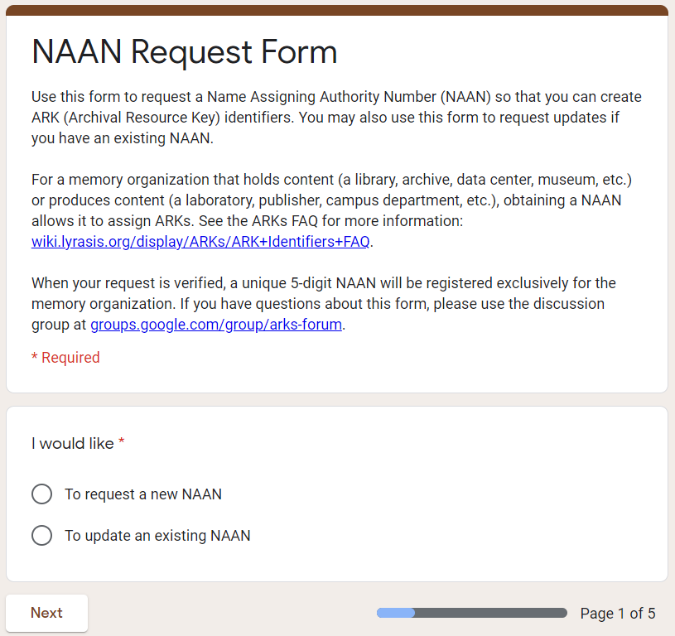
Resolvers

Slide 10
ARKS and

Slide 11
University of north Texas
Etc.
Source: University of Texas Digital Libraries

Slide 12
Future work
Source: Museum of Imaginary Musical Instruments

Slide 13
Q&A
Mat Kelly Assistant Professor, Information Science College of Computing and Informatics Drexel University mkelly@drexel.edu | Jane Greenberg Alice B. Kroeger Professor and Director, Metadata Research Center College of Computing and Informatics Drexel University jg3243@drexel.edu
Christopher Rauch College of Computing and Informatics Research Assistant at CCI Drexel University cr625@drexel.edu | Sam Grabus Research Assistant, MRC LEADING Project Manager College of Computing and Informatics Drexel University smg383@drexel.edu
Joan Boone Senior Research Analyst and Instructor College of Computing and Informatics Drexel University jpb357@drexel.edu
Peter Logan Professor Emeritus and Director of Digital Scholarship Center Temple University peter.logan@temple.edu | John Kunze Identifier Systems Architect California Digital Library University of California, Berkeley jak@ucop.edu

Slide 14
Resources
IETF Draft ARK specification: https://datatracker.ietf.org/doc/draft-kunze-ark
ARKs in the Open Project: https://wiki.lyrasis.org/display/ARKs/ARKs+in+the+Open+Project
noid utility: https://metacpan.org/pod/distribution/Noid/noid
Register a NAAN:
Create an ARK: https://ezid.cdlib.org
University of North Texas Digital Libraries ARK Presentation
https://digital.library.unt.edu/ark:/67531/metadc28359/m2/1/high_res_d/ARK_for_persistent_ID.pdf

