Slide 1
Modeling Ephraim Chambers’ Knowledge Structure from a Naïve Standpoint
Scott McClellan, MRC/CCI, Drexel University, sm4522@drexel.edu
Mat Kelly, MRC/CCI, Drexel University, mrk335@drexel.edu
Jane Greenberg, MRC/CCI, Drexel University jg3243@drexel.edu

Slide 2
Overview
What is Chambers’ Cyclopaedia? And why is it important?
Naïve vs Informed Modeling
Modeling
Thesaurus
Ontology
Implicature
Conclusions

Slide 3
Chambers’ Cyclopaedia
Published 1728
“Preface” lays out knowledge structure
Taxonomic tree
Domain vocabulary
Taxonomic graphically represents abstract knowledge
Lowest nodes of the tree are (mostly) the domain vocabulary headwords
Domain vocabulary
Structured sets of related terms

Slide 4
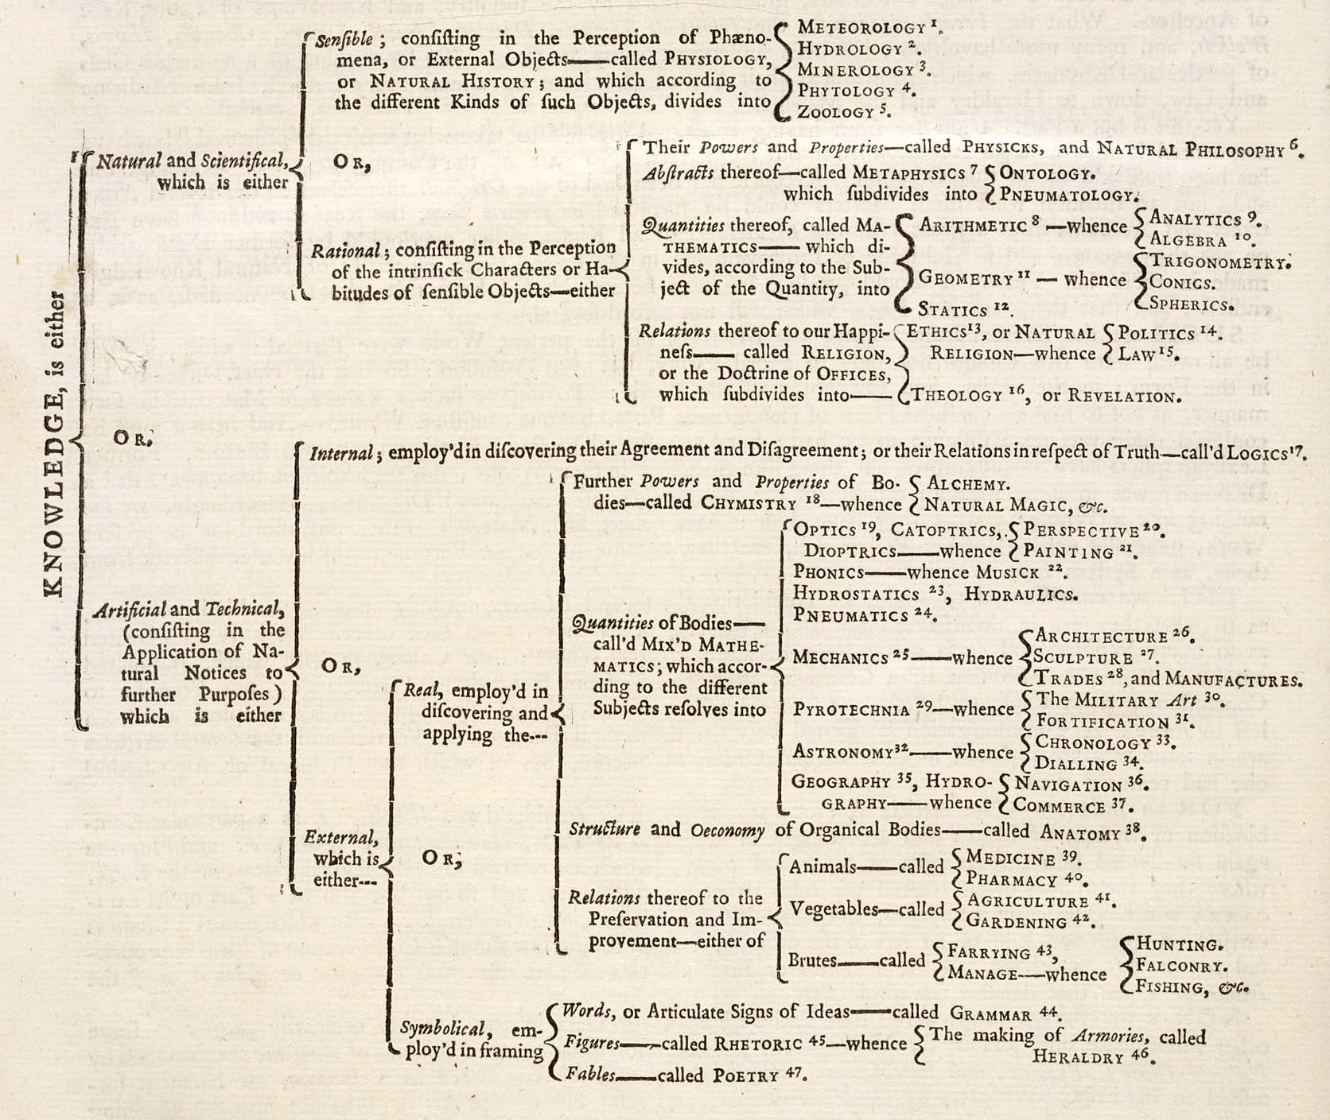
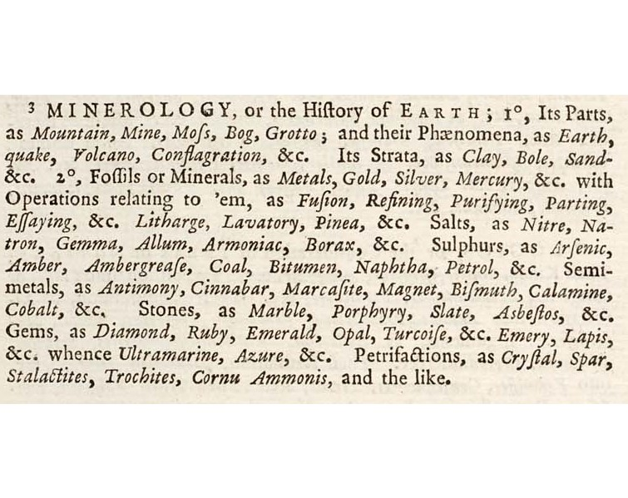
Taxonomic Tree
Domain Vocabulary (Example)

Slide 5
Naïve vs Informed Modeling
What is meant by naïve:
Less knowledge about underlying subject
Less access to a subject matter expert
Less familiarity with system of expression
Spectrum
Modelers vary in degrees of expertise and naivete
Crossover skills
Language
Adjacent Studies

Slide 6
Thesaurus/Ontology
 | Thesaurus | Ontology
Pro | Expresses basic hierarchy well Easier to reconcile logical inconsistencies, e.g., duplicate terms Describes domain vocabulary well | More robust class and sub-class descriptions Expresses complex connections between and across classes Incorporates taxonomic tree structure
Con | Facets sometimes difficult to describe Relationships tend to be less expressive | Model relies on greater understanding of logic Tend to be more interpretive than descriptive

Slide 7
Implicature
“Our talk exchanges do not normally consist of a succession of disconnected remarks and would not be rational if they did. They are characteristically, to some degree at least, cooperative efforts; and each participant recognizes in them, to some extent, a common purpose or set of purposes, or at least a mutually accepted direction” –Paul Grice, Studies in the Ways of Words, 26
Attempts to understand how participants in a conversation derive meaning from each others’ utterances based upon situation and environment
Modified Occam’s Razor: Try not to allow meaning to proliferate
Lack of a physical second actor complicates the theory

Slide 8
Implicature Continued
Applying the theory to Chambers’ vocabulary
Descriptive connectors
Typographical features
Shared language (for English speakers)
Well adapted for more descriptive knowledge organizations (e.g., thesaurus)
Problematic Points
Subtle shifts in language usage across time
Lack of deictic markers in places
Less useful in low-context situations (e.g., taxonomic tree)

Slide 9
Conclusions
Information needs of the end user define the best model
Encoding in Simple Knowledge Organizing System (SKOS)
Integration into the Metadata Research Center’s Helping Interdisciplinary Vocabulary Engineering (HIVE) application
Continued research with the 19th Century Knowledge Project and persistent identifiers for computational vocabulary work

Slide 10
Acknowledgements
Joseph Tennis & Christopher Hodges, top-level SKOS encoding
Sam Grabus & Jane Lippman, extended SKOS encoding
Peter Logan, PI 19th Century Knowledge Project
Grice, P. (1989) Studies in the ways of words. Harvard: Cambridge.

