Slide 1




To Re-experience The Web:
A Framework For The Transformation And Replay Of Archived Web Pages
John Berlin, Mat Kelly,
Michael L. Nelson, Michele C. Weigle
Presented by Lesley Frew and Himarsha Jayanetti
“When you have eliminated the JavaScript,
whatever remains must be an empty page”
Notes:
https://matkelly.com/papers/2023_tweb_preprint.pdf

Slide 2
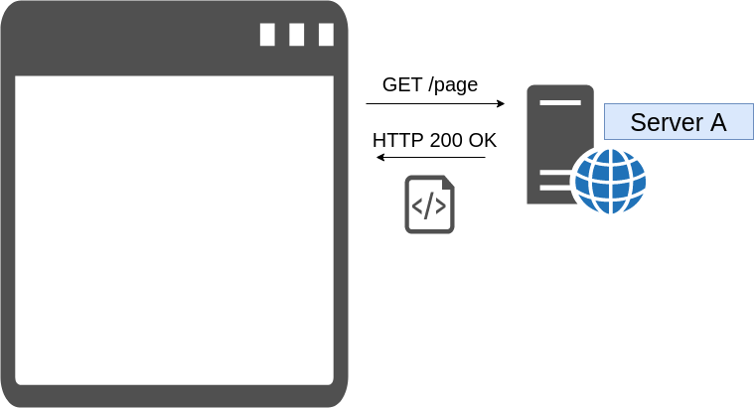
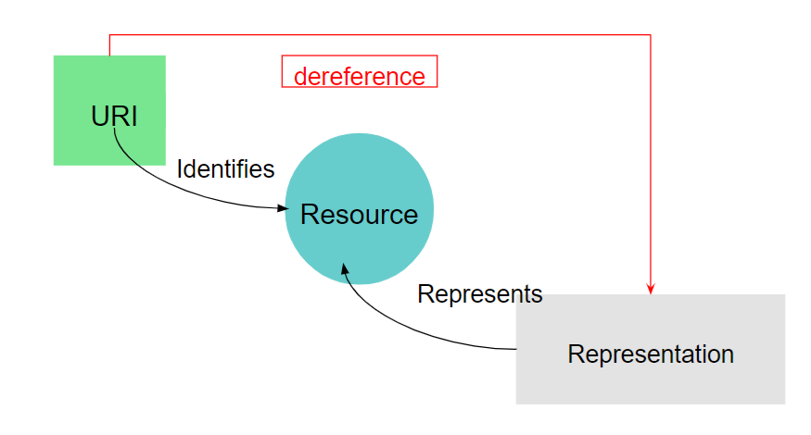
Viewing Live Web Pages
Enter a URL into the navigation bar of the browser
Browser navigates to the web page the URL Points To by
Retrieving (Dereferencing), the Representation of the page (HTML) from server

Slide 3
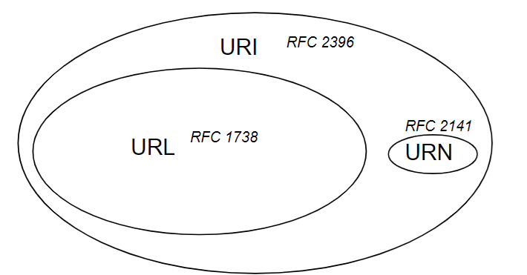
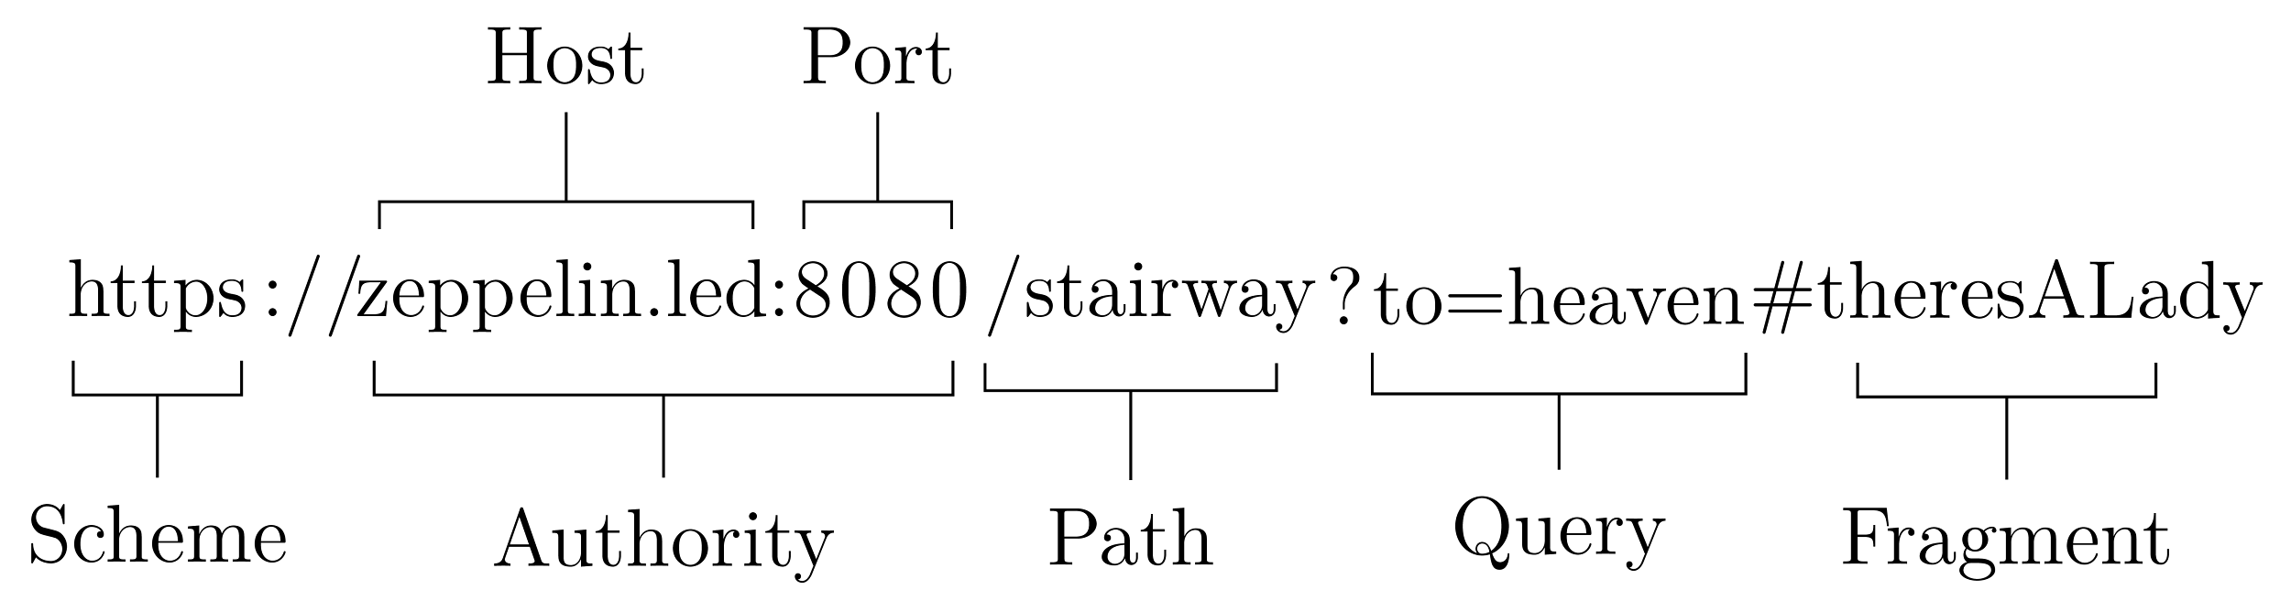
Uniform Resource Locators (URLs)
URLs are more specific Uniform Resource Identifiers (URI)
They describe how to Access resources on the Live Web
Identify resources on the Live Web
Provide means for Locating resources on the Live Web

Slide 4
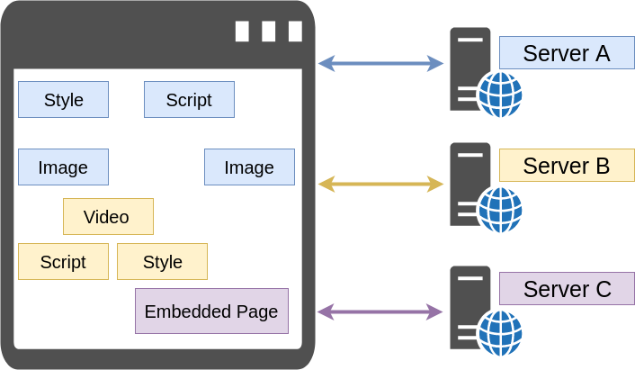
Browser To Fetch Resources
Browser
Parses the pages HTML
Retrieves embedded resources
Executes embedded scripts (JavaScript)
Parses and applies style sheets (CSS)
Embedded resources can
come from Multiple servers
And each embedded resource has a URL Indicating where to retrieve it
from

Slide 5
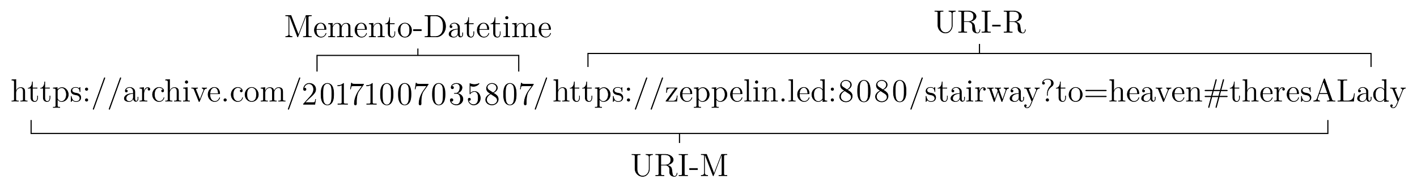
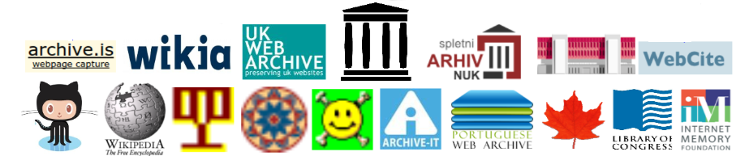
Requesting a page from the Past Web: Mementos And Their URI-Ms
Mementos
Archived resources
Retrievable from an Archive
URI-M (URI-Memento)
A URI that identifies an Archived resource
That existed at preservation time (Memento-Datetime)
URI-R
The Original URI of the Resource

Slide 6
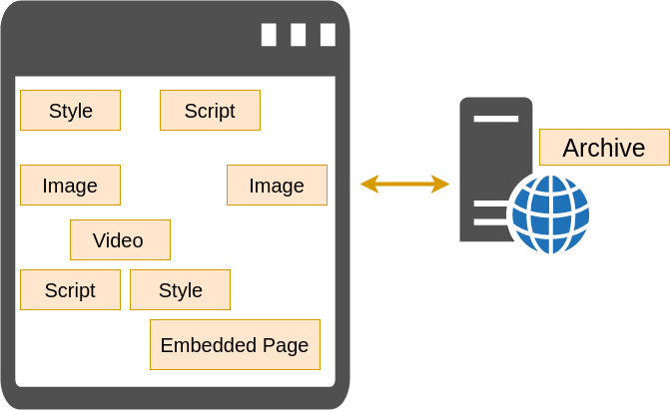
Viewing Archived Web Pages
This is called Replay
You view archived web pages at the Datetime of preservation
Page and embedded resources (Mementos) come from a
Single Source, the Archive
But replay relies on archive’s ability to Facilitate replay

Slide 7
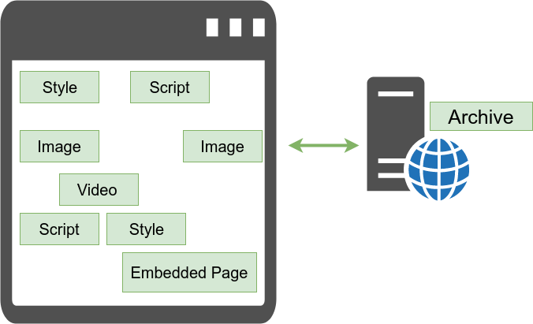
Facilitating Replay An Overview
In order to replay archived web pages from an archive
Archives MUST Rewrite URI-Rs to URI-Ms
<!-- pre rewritten -->
<link rel="stylesheet" href="http://awesome.com/blackflag/foreverTime.css">
<!-- post rewritten -->
<link rel="stylesheet" href="http://archive.com/20171007035807cs_/http://awesome.com/blackflag/foreverTime.css">
In order for you to relive the past web
Live Web
Replay
Web Archiving

Slide 8
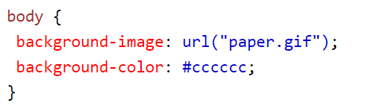
Archival Linkage Modifications
Modifications made in order to serve (replay) mementos from the archive
Rewriting of URI-Rs contained within archived
HTML
JavaScript
CSS
Not applicable to Media Types
Images
Audio
Video
PDF
No URI-Rs within that cause resource fetches

Slide 9
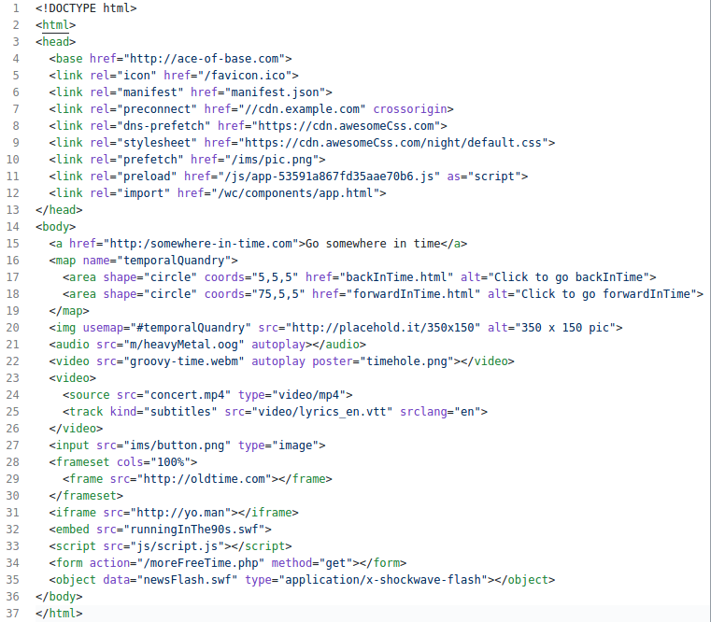
When Archival Linkage Modifications To HTML Were Simple
Need To Rewrite URI-Rs
That
Embed Resources
Link To Resources
Link To Another Page
HREF
Poster
SRC
Action
Data

Slide 10
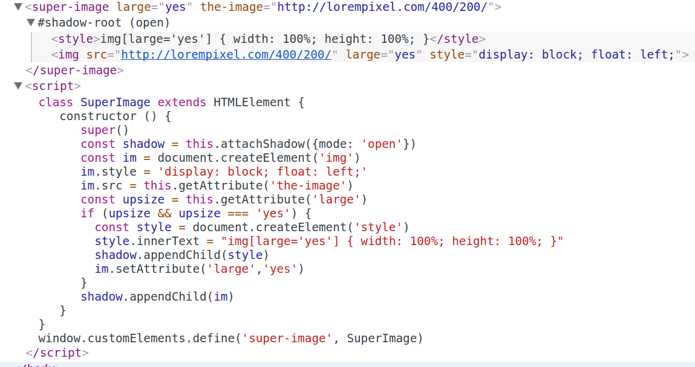
When JavaScript and HTML Combine
HTML5 Introduced
data-* attributes
custom elements
Well attributes and their values can be “anything”
They all become either JavaScript Content/IDL attributes
Custom Element
Actual HTML Deferred
Until This Is Executed
CSS works with Custom Attributes

Slide 11
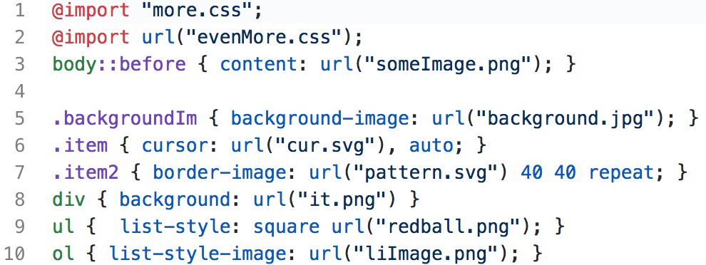
Archival Linkage Modifications Of CSS
URLs exist in CSS via @import and url keywords
3 Primary Patterns
2
1
3

Slide 12
Preventing Poor/Insecure Replay: Replay Preserving Modifications
Negates intended semantics of specific HTML element and attribute pairs
To prevent the Zombie Apocalypse of course!
<meta http-equiv="refresh" content="35;url=?zombie=666">
Attribute Prefixing: <meta http-equiv="refresh" _content="35;url=?zombie=666">
Also effective in fending off those pesky integrity attribute demons
<link rel="stylesheet" integrity="sha384-eKdwSs2g6PL+F9/RnQ14sov7h5SAFYgq8WJln2tXHOSW/7fJt4G+Td7PcVzkJunk">
<script src="theScript.js" integrity="sha256-qerliYS7q6jrFLa4BJJ3g1ua00vkPz9SjuYsHPLpVzE="></script>
Original Content Hash
Archives
Rewrite URI-Rs found in CSS and JS
Add disclaimers to the preserved resource
Browser hash != embedded integrity hash
Thus browser no load
http://ws-dl.blogspot.com/2014/07/2014-07-14-refresh-for-zombies-time.html

Slide 13
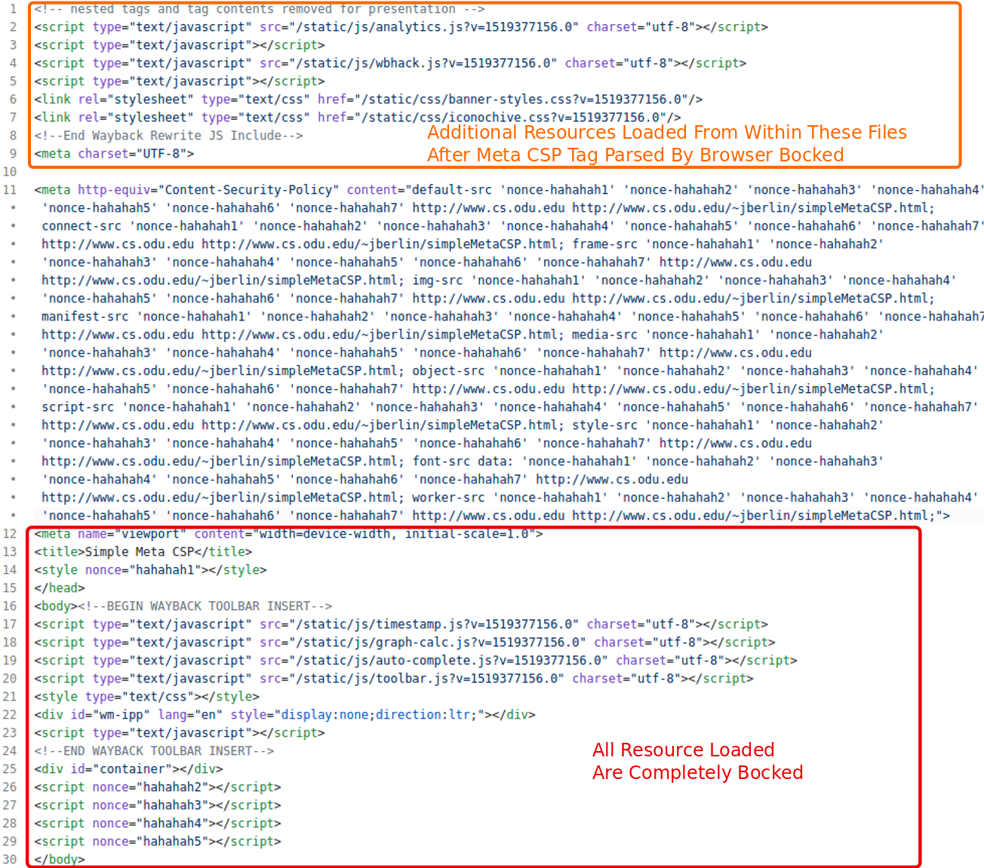
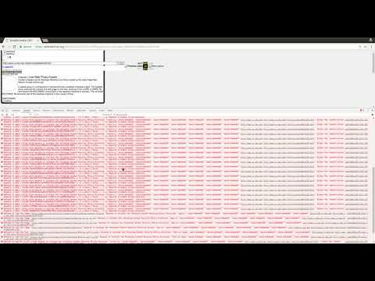
It's Just A Matter Of Time Until HTML “Attacks”
Meta tag delivered Content-Security-Policy!
Chrome >= 25, Edge >= 14
FireFox >= 23, Opera >= 15, Safari >= 7

Slide 14
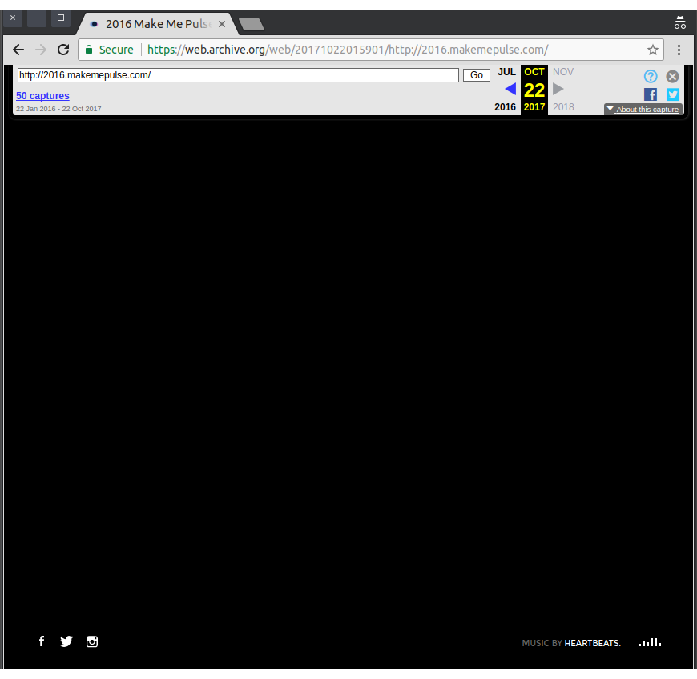
Wayback Style: Integrated Replay
The OG way to replay web pages
No Separation of
Replayed Page
Archive Controlled Banner
1 Domain, 1 Page
Archive (banner)
web.archive.org
+
Replay (memento)
web.archive.org
Notes:
Thank you, Lesley. I will discuss the modifications applied in Wayback style replay and the differences between systems that use integrated replay and those that use sandboxing.
In integrated replay systems like the IA's Wayback Machine, the banner .html/.js is injected into the replayed archived page; it doesn't use iframes.

Slide 15
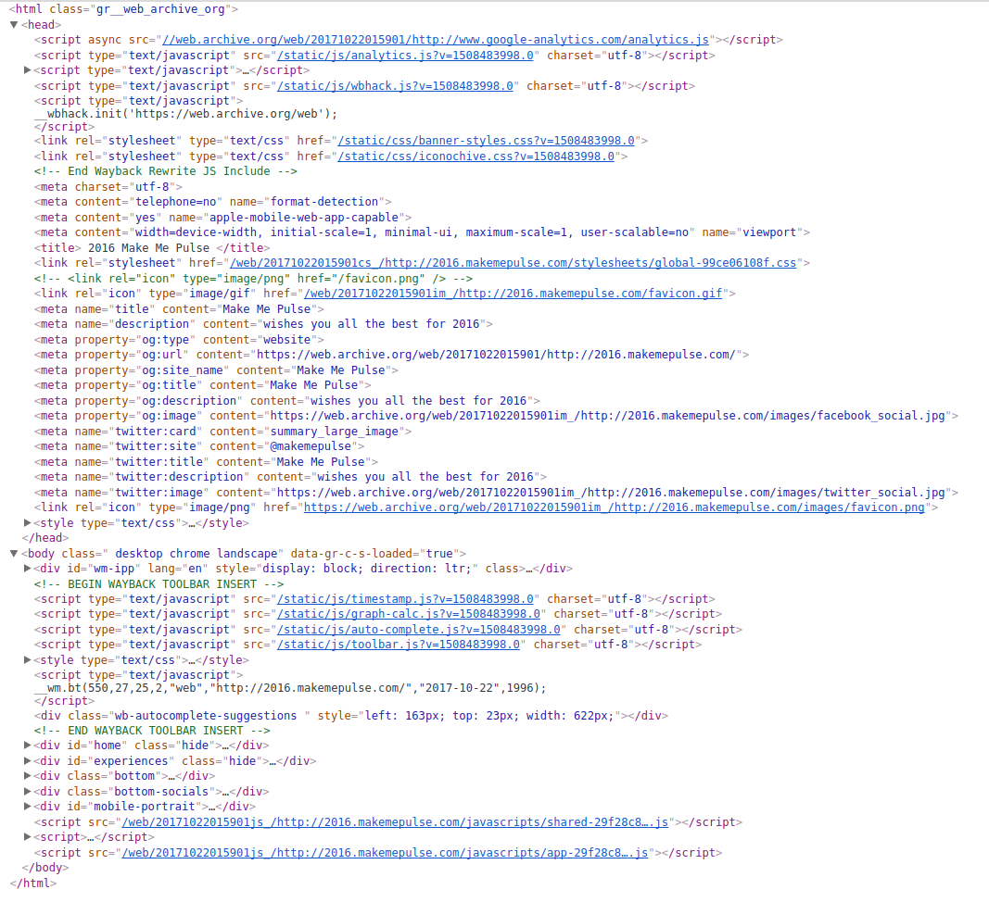
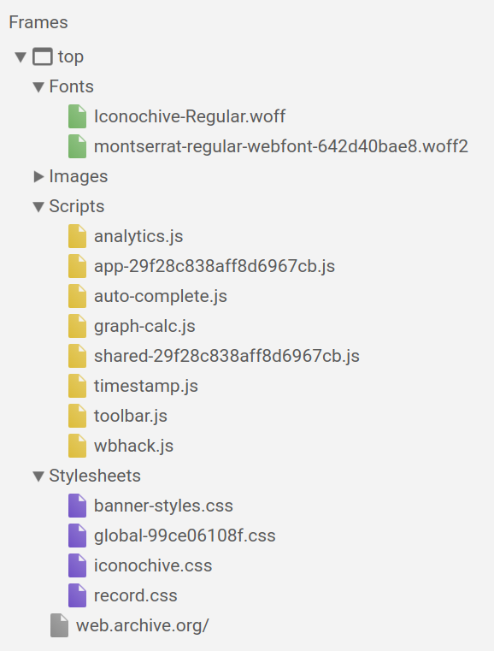
Wayback Style: Integrated Replay
web.archive.org
web.archive.org
web.archive.org
memento
web.archive.org
memento
banner

Slide 16
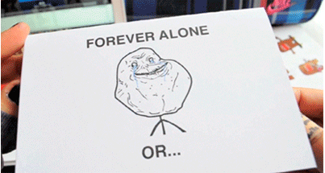
When Integrated Replay is Used
Because the archived controlled portion of replay (banner)
and the replayed memento are on the same domain
The replayed memento can interact with the banner or disrupt archive’s control

Slide 17
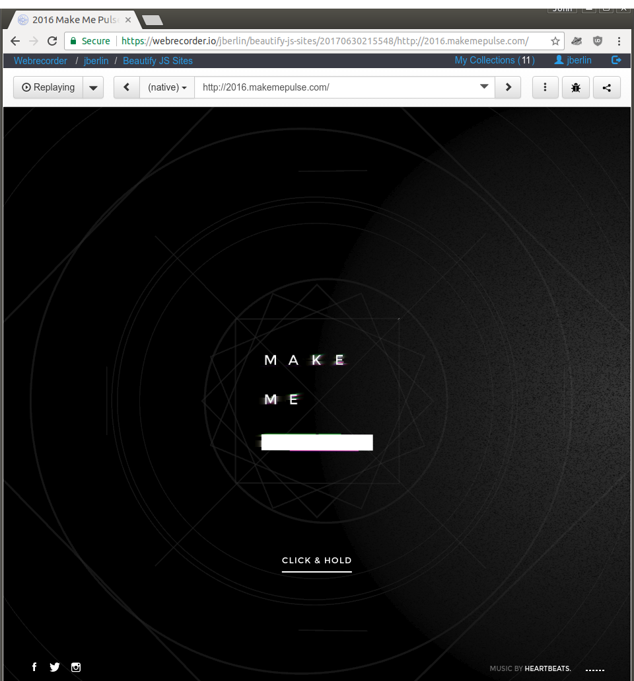
Wayback Style: Sandboxed Replay
Google Chrome: 2 parts, 1 Browser
Browser Kernel (Controller Of Renderer. Warden of HTTP, Filesystem access)
Renderer (JavaScript, HTML, CSS engines….)
Chrome always assumes:
“Renderer is always compromised”
Sandboxed Replay shares in this assumption
“Replayed Pages Always Compromised”
2 Domains, 1 Page
Archives (Browser Kernel)
webrecorder.io
Replay (Renderer)
wbrc.io

Slide 18
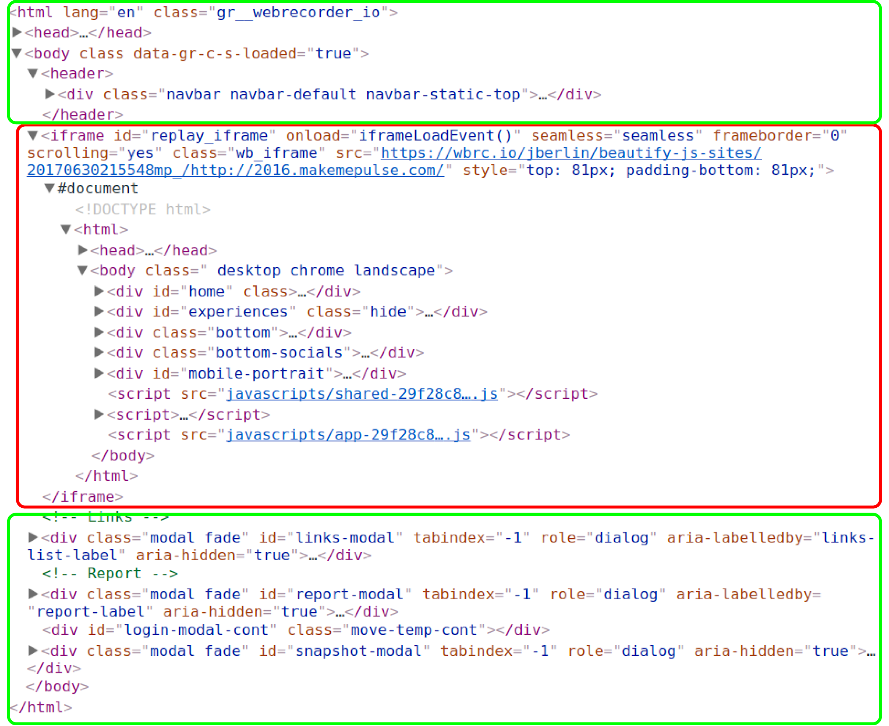
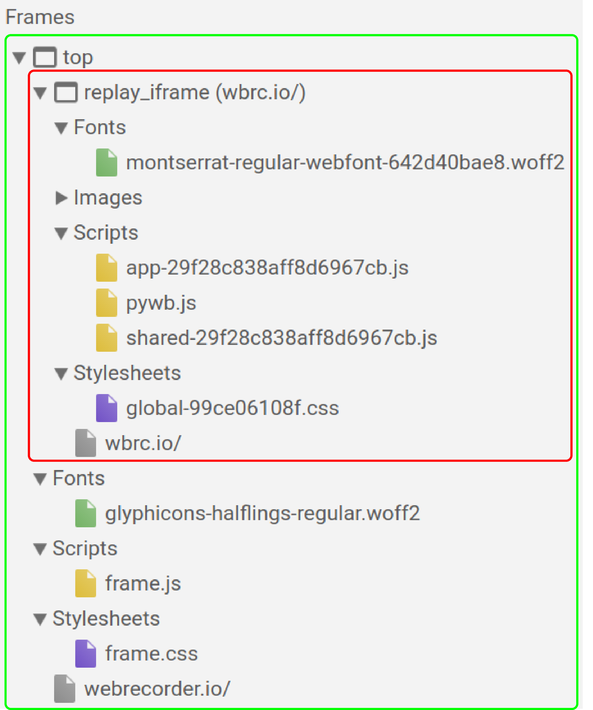
Sandboxed Replay Isolation In Use
webrecorder.io
banner
wbrc.io
wbrc.io
memento
memento
webrecorder.io
webrecorder.io

Slide 19
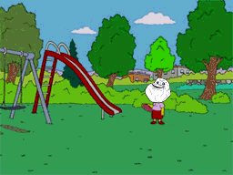
When Replay Isolation Is Used
wbrc.io is forever alone and separate from webrecorder.io
Because pages on different domains CANNOT directly interact with each other due to browser security restrictions (Same-Origin Policy)

Slide 20
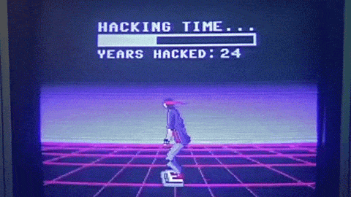
Temporal Jailing
Ensures archived JavaScript CANNOT
Hack Time (escape Memento-Datetime)
Reach out to live web (zombies)
Tamper with archive control
Happens client-side
JavaScript URL rewriting using overrides of
cnn.com
Location Exposing JavaScript APIs
document.location, window.location, location, document.domain
URL Changing New Window Cookies
window.history | window.open | document.cookie
HTTP Requests Iframe Communication
XMLHttpRequest, window.fetch | postMessage | …….
HTML Element APIs That
Create/Modify Markup
Insert/Create CSS
…..
mendeley.com

Slide 21
JavaScript For The Preservation And Replay Of The Modern Web
Current de facto solution to the JavaScript problem is Pywb and Webrecorder’s client-side rewriting library
wombat.js
It performs same rewriting done server-side plus
Targeted JavaScript API overrides for rewriting the URLs they operate on
But
It is a
Handcrafted library specifically tailored for Pywb and Webrecorder
Fix?????

Slide 22
JavaScript For The Preservation And Replay Of The Modern Web
Turning to the HTML Specification
This specification uses the term document to refer to any use of HTML, . . . , as well as to fully-fledged interactive applications. The term is used to refer both to Document objects and their descendant DOM trees,
...
User agents that support scripting must also be conforming implementations of the IDL fragments in this specification, as described in the Web IDL specification

Slide 23
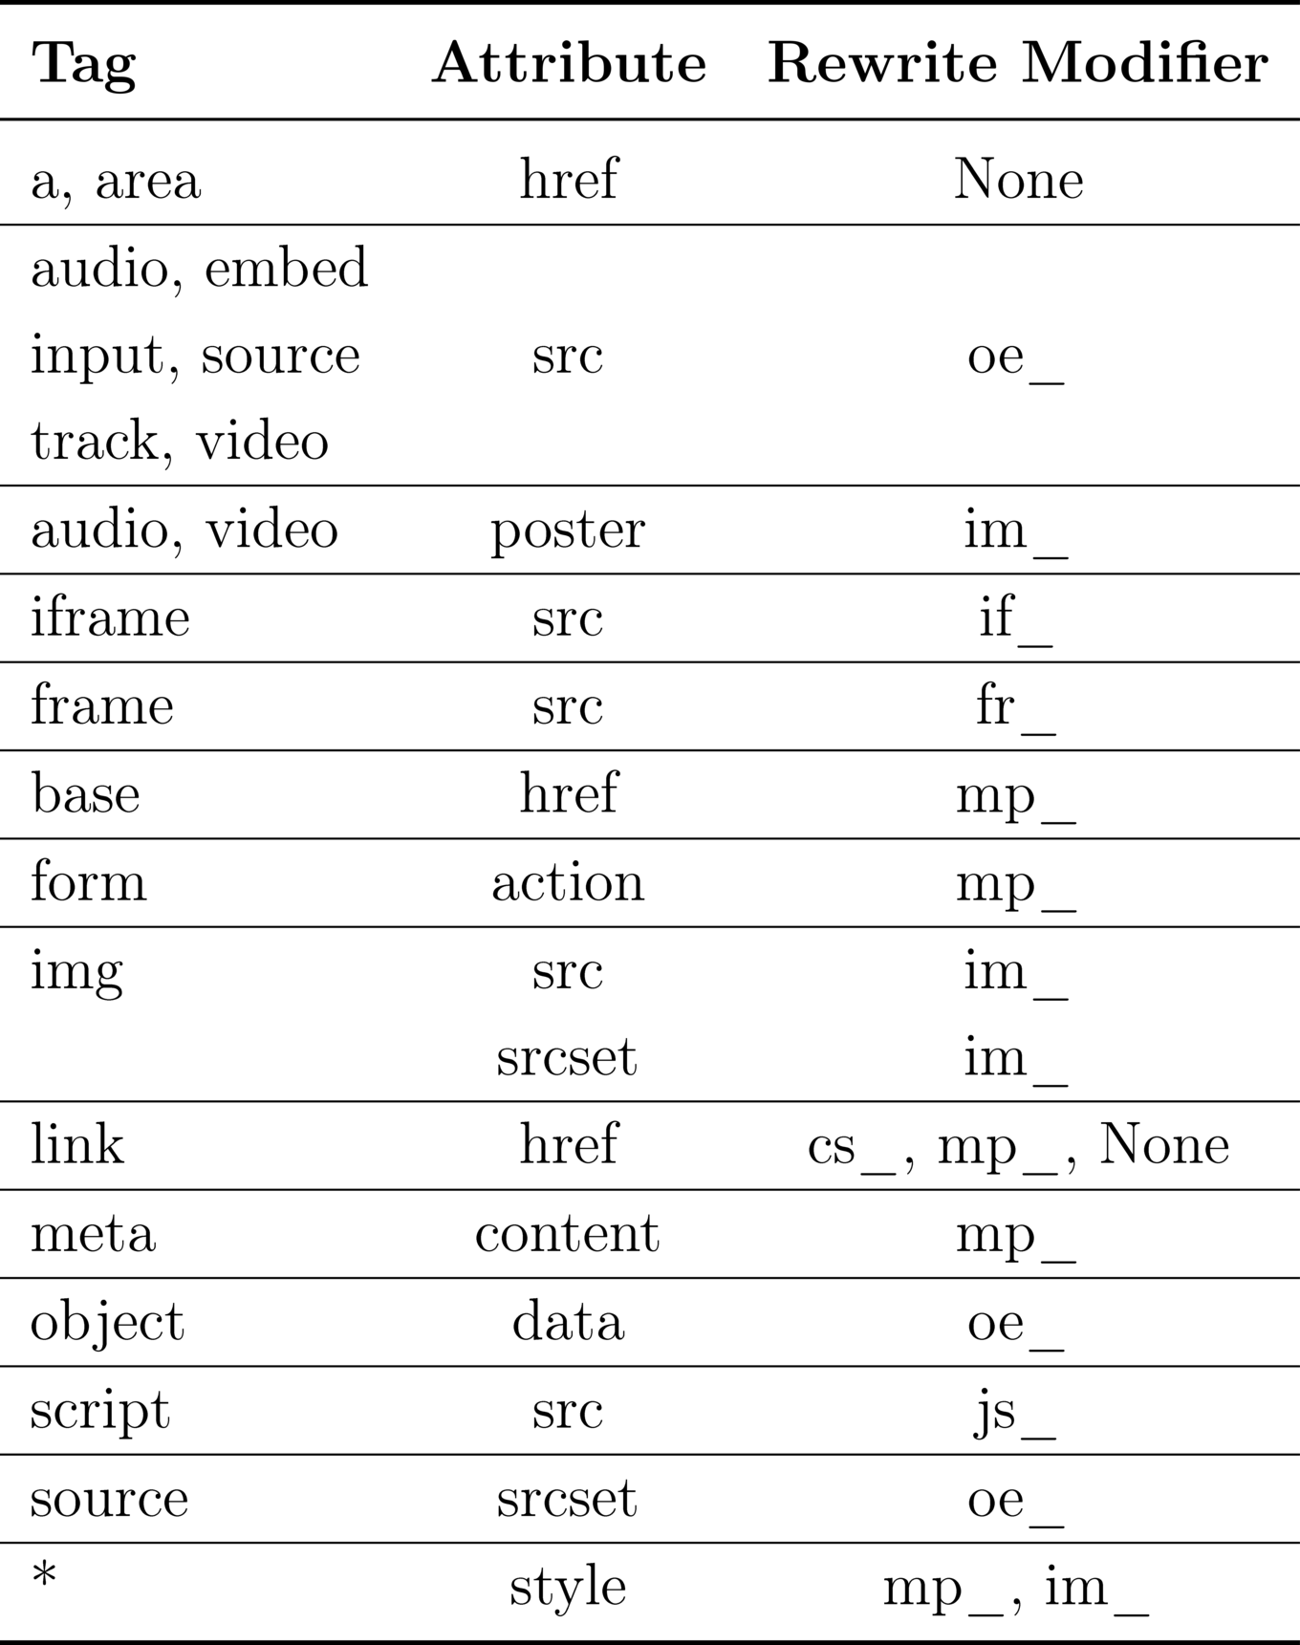
Auto-Generating A Client-Side Rewriter
Goal of URL rewriting: Rewrite All The URLs!
Cannot rewrite URLs unless we know where to look
Sooooo….. Let's borrow from server-side rewriting
It knows where to look pretty good
This gives us 7 “normal” attribute identifiers
href
src
srcset
action
content
data
poster
And a special one style

Slide 24
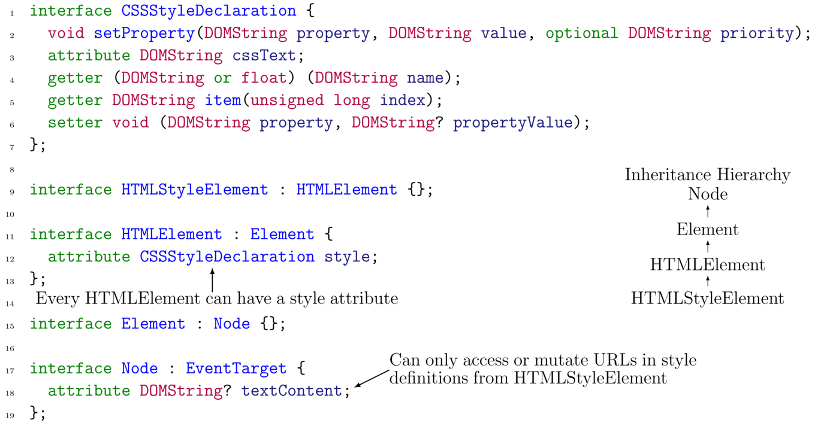
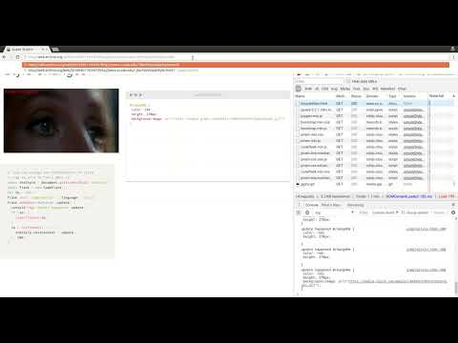
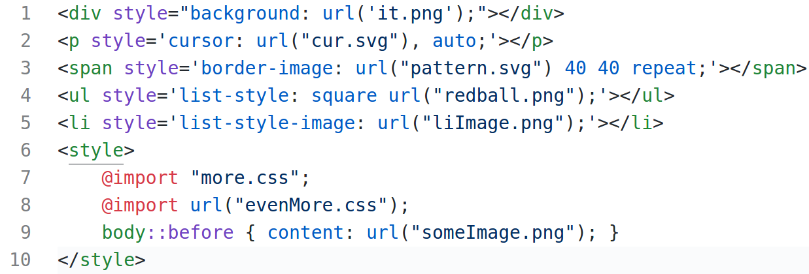
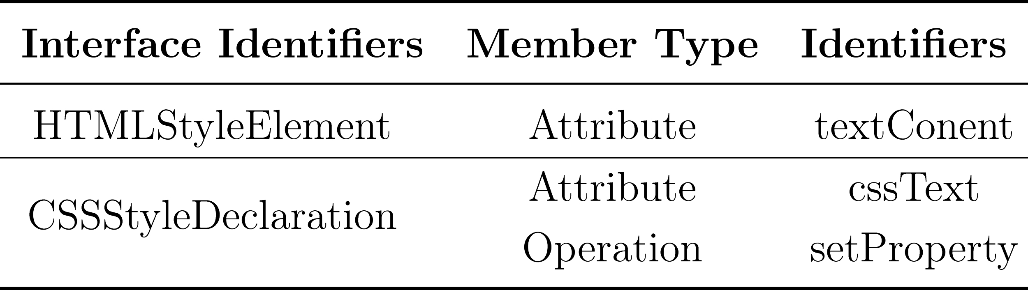
Style And Resource Fetches
Look the three patterns!

Slide 25
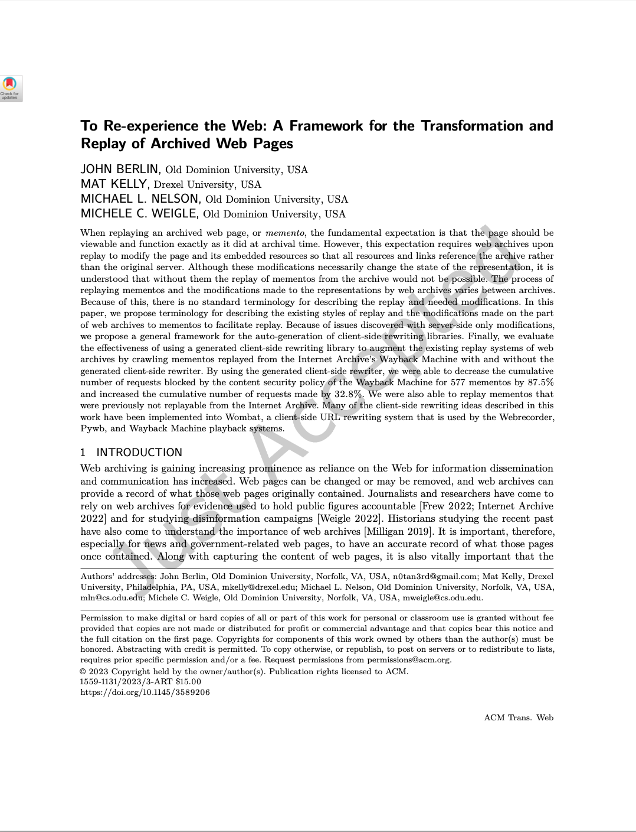
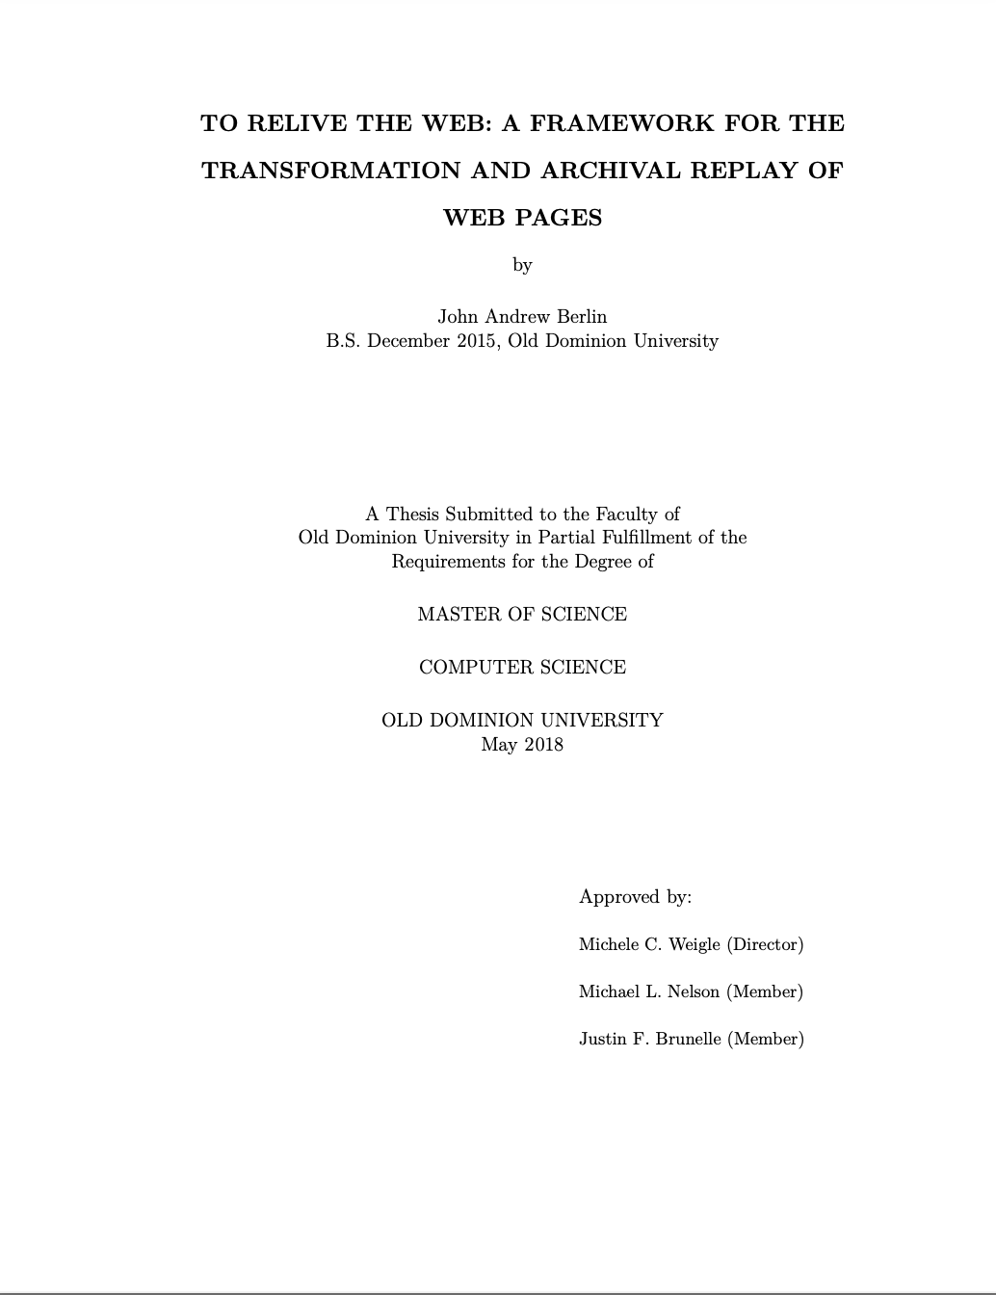
Key Takeaways:
Details, code, evaluation, etc. in blog, MS Thesis, ACM TWeb
Berlin was one of the first to consider what happens when a web archive ingests malicious pages
IDL provides a principled way to discover where all URLs are hiding in an archived web page
The way that the Wayback Machine and PyWB rewrite pages has changed because of this work
https://ws-dl.blogspot.com/2018/04/2018-05-01-high-fidelity-ms-thesis-to.html,
https://digitalcommons.odu.edu/computerscience_etds/38/, https://dl.acm.org/doi/10.1145/3589206

