Slide 1
Weaving in the Loose Ends
Of Novel Web Archiving Approaches
Mat Kelly, PhD
Assistant Professor, Information Science
Drexel University, College of Computing & Informatics (CCI) Philadelphia, PA
mkelly@drexel.edu
https://matkelly.com @machawk1 Save All the Internet: Web Archiving Tools and Tips March 30, 2020, University of Delaware
slides: https://matkelly.com/saveTheInternet

Slide 2
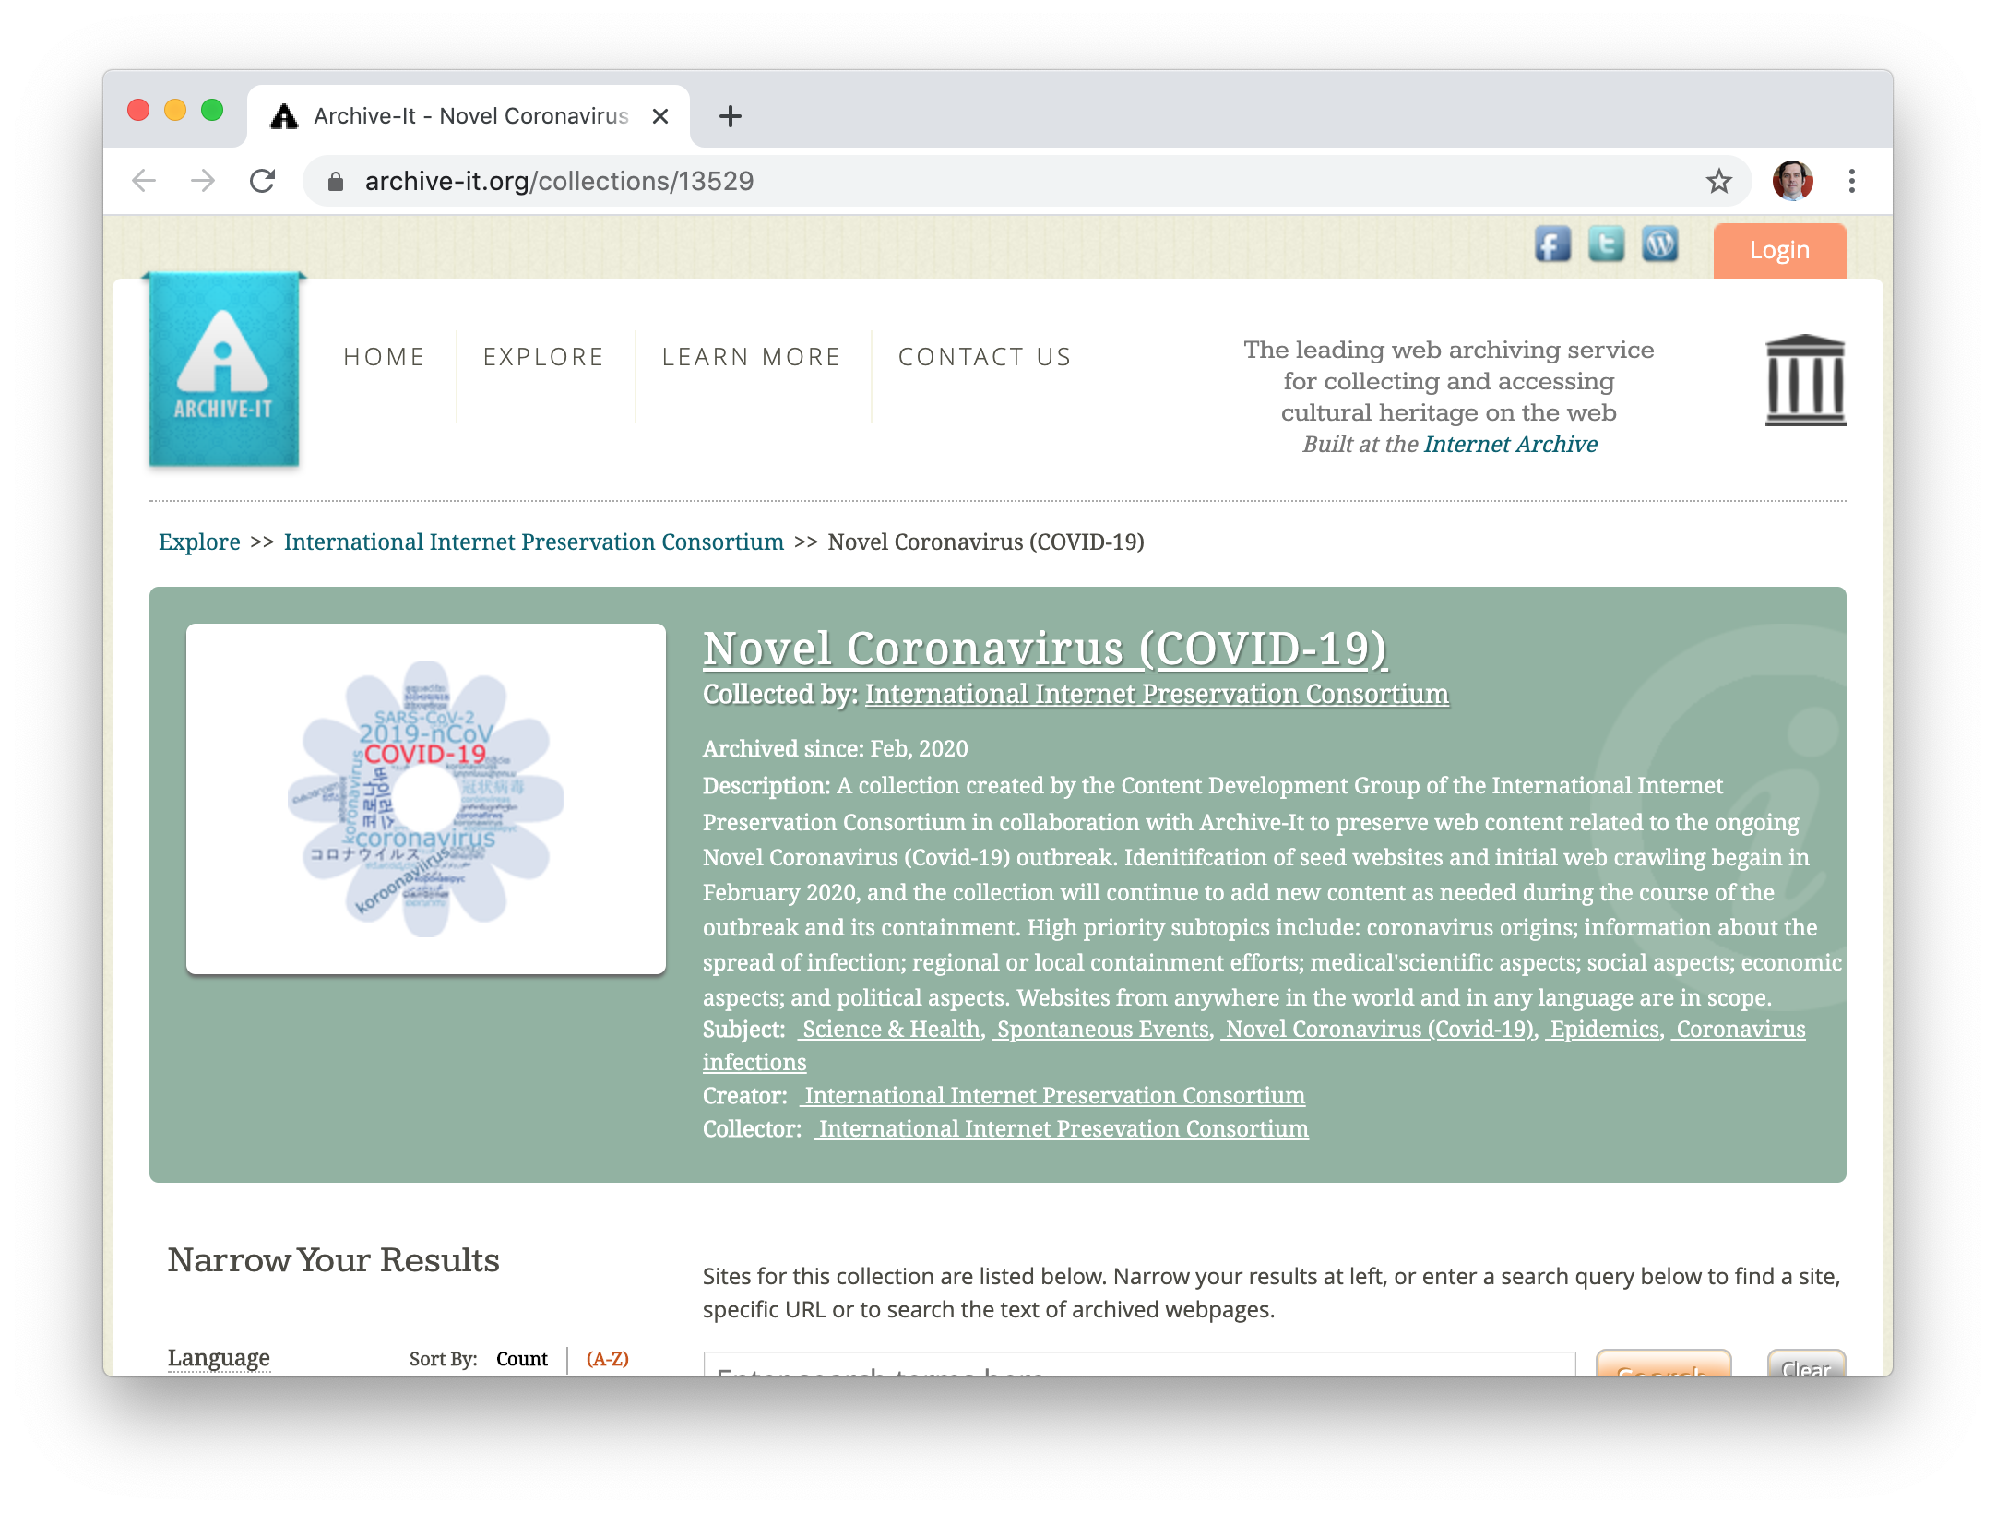
Loose Ends
Preservation
Web Archiving by reference (URI) vs. value (representation)
Institutional-driven vs. user one-off vs. personal web archiving
Access
Request web history by URI, be glad that some results exist
Tools galore but lots of redundancy of various qualities, minimal efforts for external integration and collaboration beyond those that want more cycles
THIS TALK: discuss previous software efforts, paradigms, and progress.

Slide 3
Can we trust tools?
Capture quality
Are we sure captures are complete? How do we evaluate this (beyond the bits)?
Ownership
Where do our captures reside? Are the raw forms accessible on-demand?
Privacy considerations
If sharing capture, can identifying or private info be selectively removed?
Execution safety
Is other data on the machine on which we run the tools safe?
Scalability
Can personal tools be used for larger endeavors?

Slide 4
“We archived web pages”
Submitting seeds to a server → “we archived”?
Delegation by reference (URI)
Easily understandable model, results sometimes insufficient/unexpected
Personal web archiving efforts’ issues:
Vetting
Completeness
Dissemination
Persistence
Privacy

Slide 5
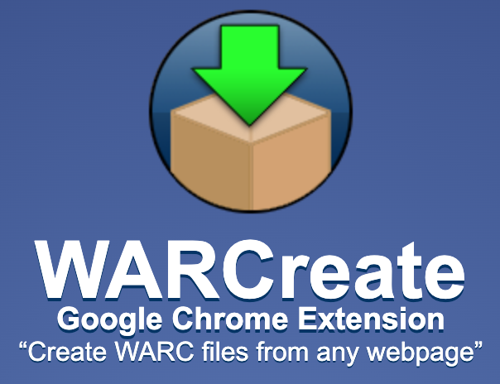
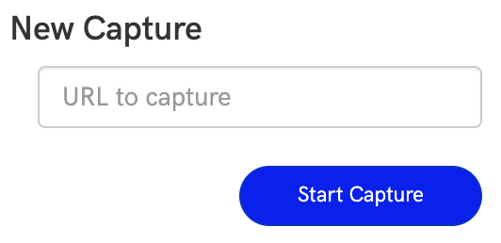
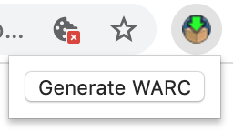
Browser-based Preservation
Via a web page
Page-at-a-time: e.g., IA’s Save Page Now (by reference, passing a URI)
Session-based archiving: Webrecorder (by value)
Destination agnostic
WARCreate¹ (by value)
All have simple interface
Varying degrees of capture quality, funding sources
¹https://warcreate.com

Slide 6
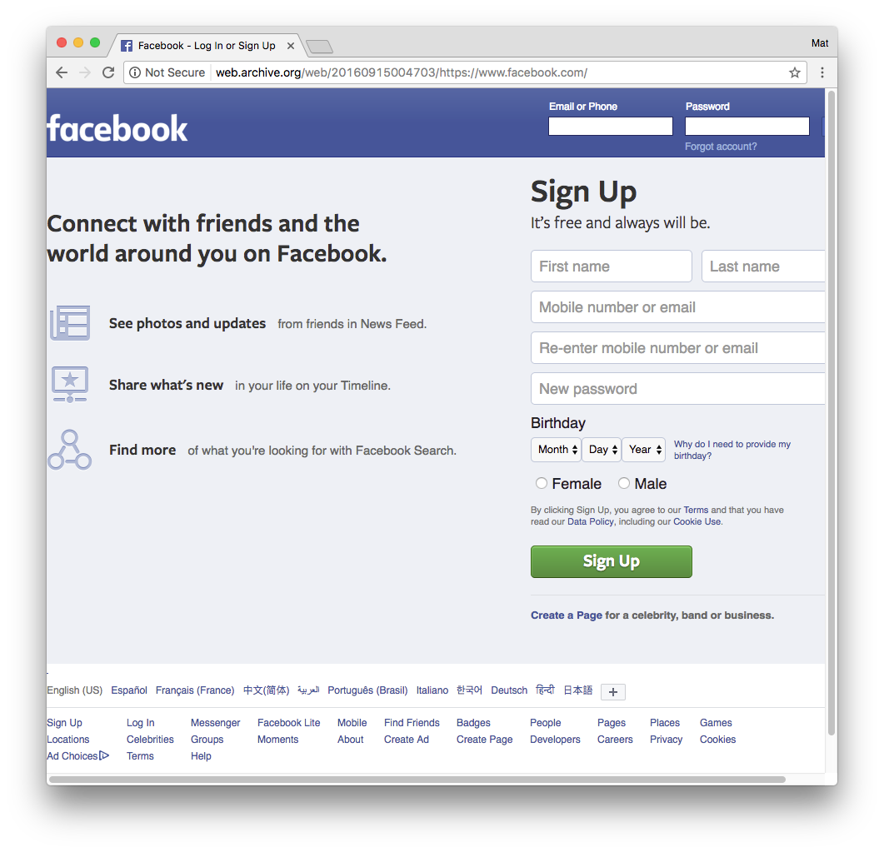
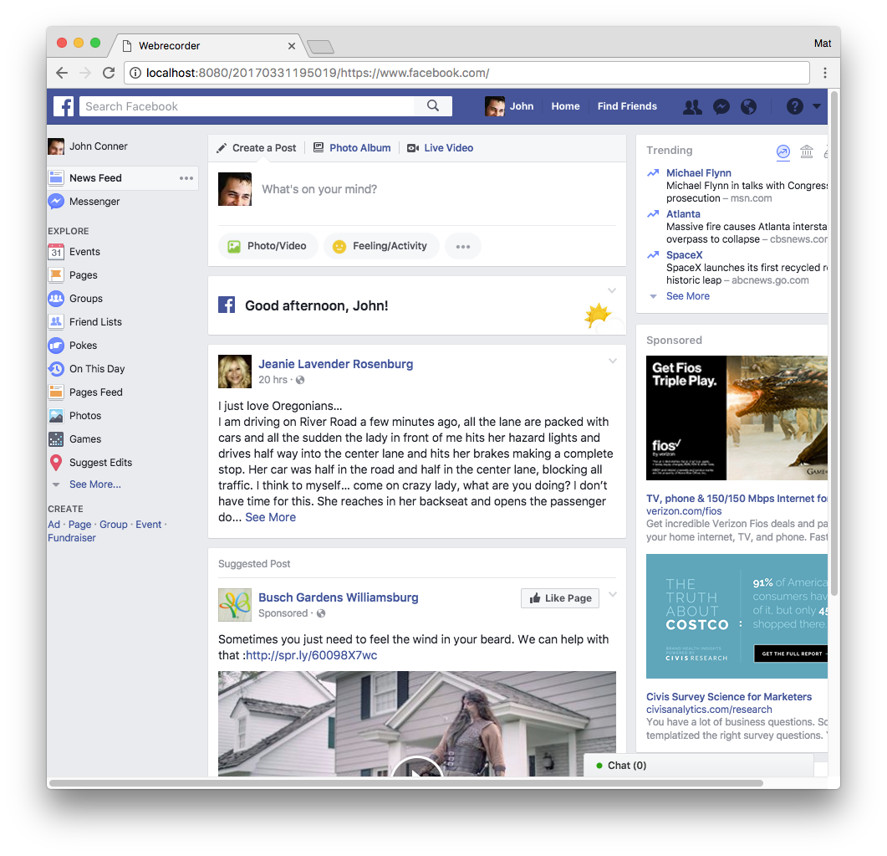
Web Archiving By-reference vs. By-value
URI (by reference) is often insufficient to obtain the representation intended to be captured
Not just authentication but page state
Facebook.com (login page) vs. Facebook.com (my feed)
Scripted automation (e.g., Autopilot¹) often helps to surface embedded resources’ representations
VS
¹https://guide.webrecorder.io/autopilot/
Hey, web archive service, archive facebook.com
Hey, web browser, Archive What I See Now*
by reference
by value
* NEH HK-50181-14

Slide 7
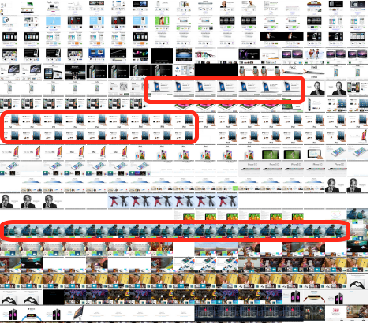
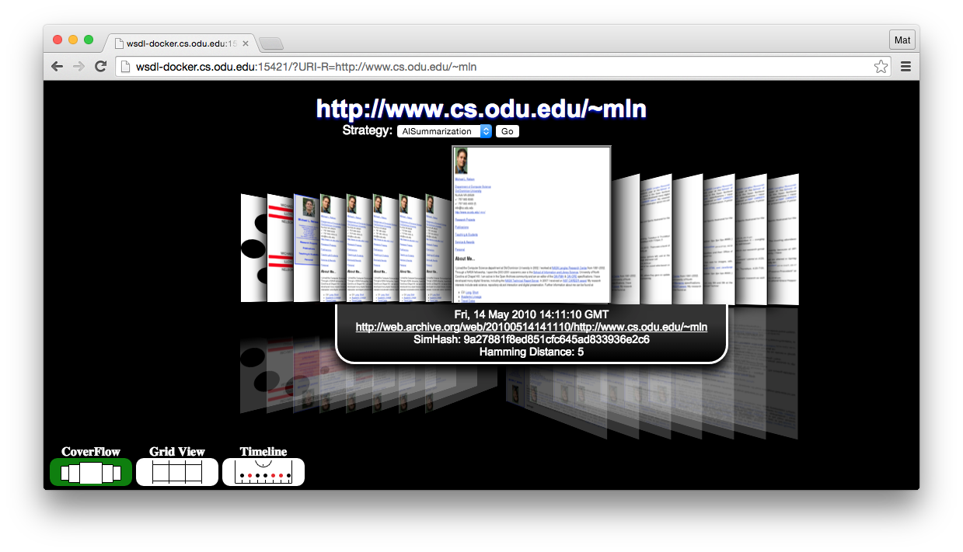
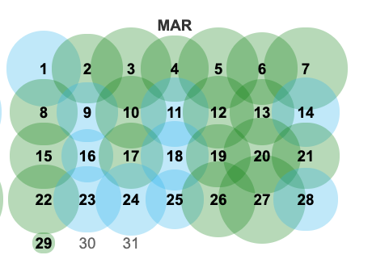
Exploration of Web Archives
Conventionally URI as parameter for navigation in time
Topical collections
e.g., @ Archive-It, manually curated
Minimal systems exist for exploring beyond URI lookup
apple.com over time
(lots of redundancy)
Archive Thumbnails service
OpenWayback

Slide 8
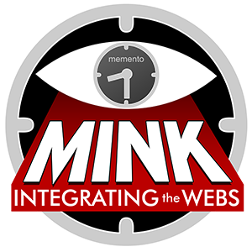
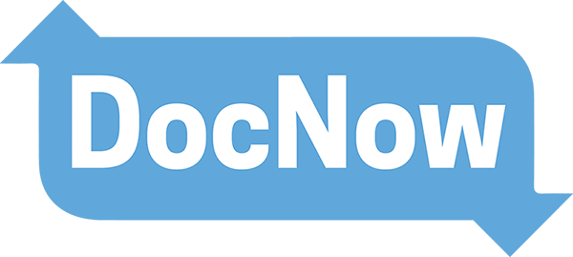
Build Client-Side Web Archiving Tools
To Empower Users to Preserve

Slide 9
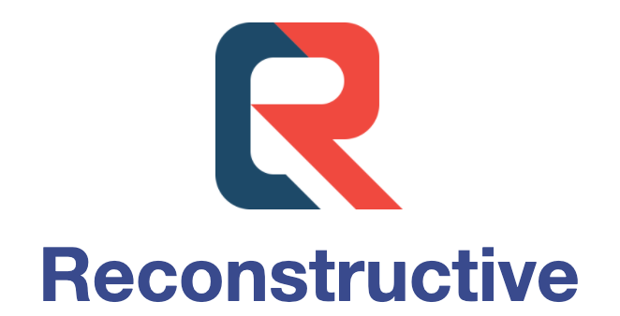
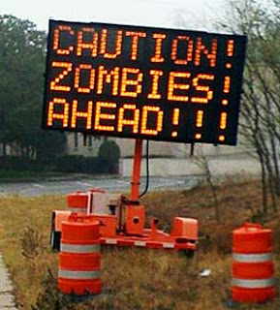
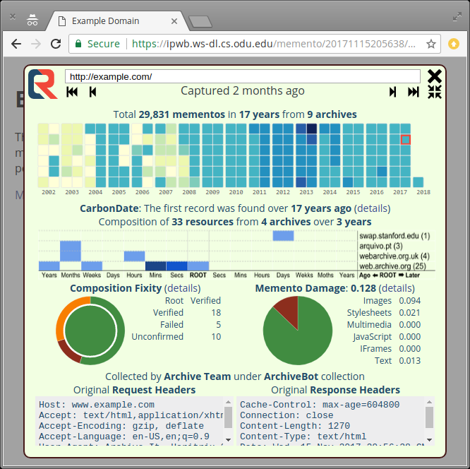
Solutions to Replay Issues
Mitigating live web leakage, “Zombies”¹
Rerouting instead of rewriting at replay time (Reconstructive²)
Prevents source modifier, better means of verifying capture integrity
Archival content is not manipulated for replay, renders more true to original form
Advanced banner
Pure client-side, web-based replay system (WABAC.js³)
Replay WARCs on-demand without uploading (using Service Workers)
¹ J. Brunelle, “Zombies in the Archives”, Oct 2012, https://ws-dl.blogspot.com/2012/10/2012-10-10-zombies-in-archives.html ² Reconstructive: https://oduwsdl.github.io/Reconstructive/
³ WABAC: https://wab.ac/

Slide 10
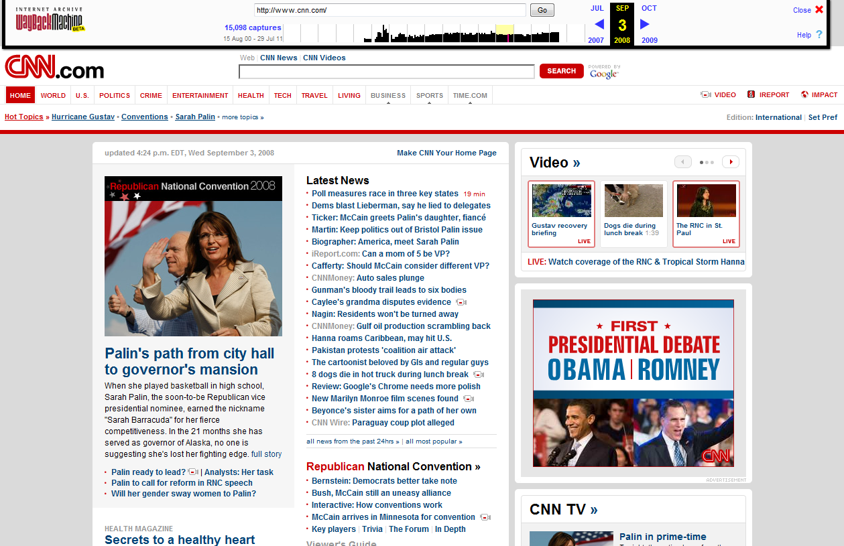
Live Web Leakage

Slide 11
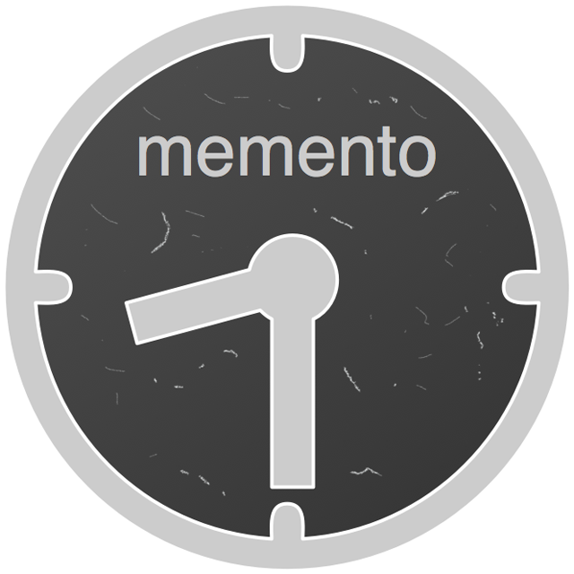
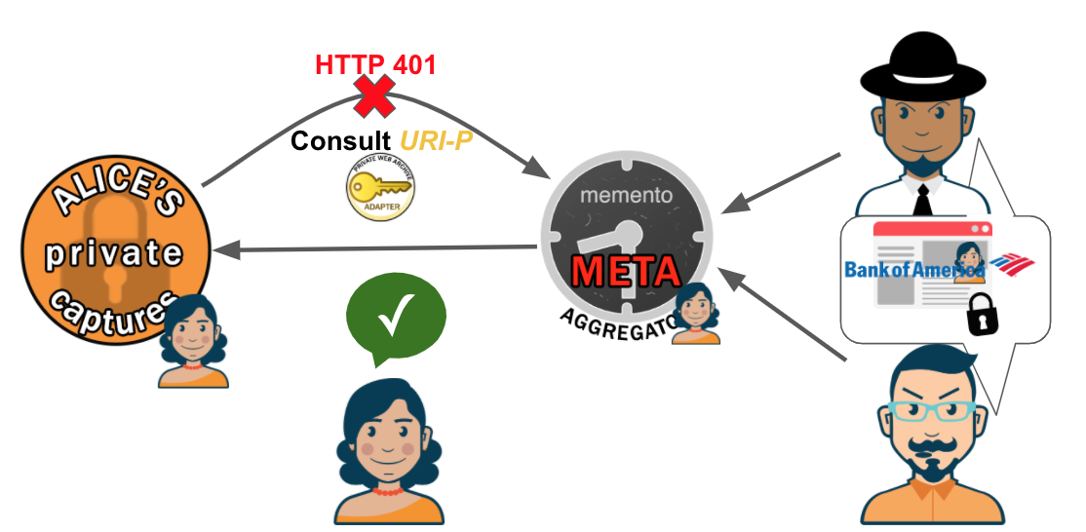
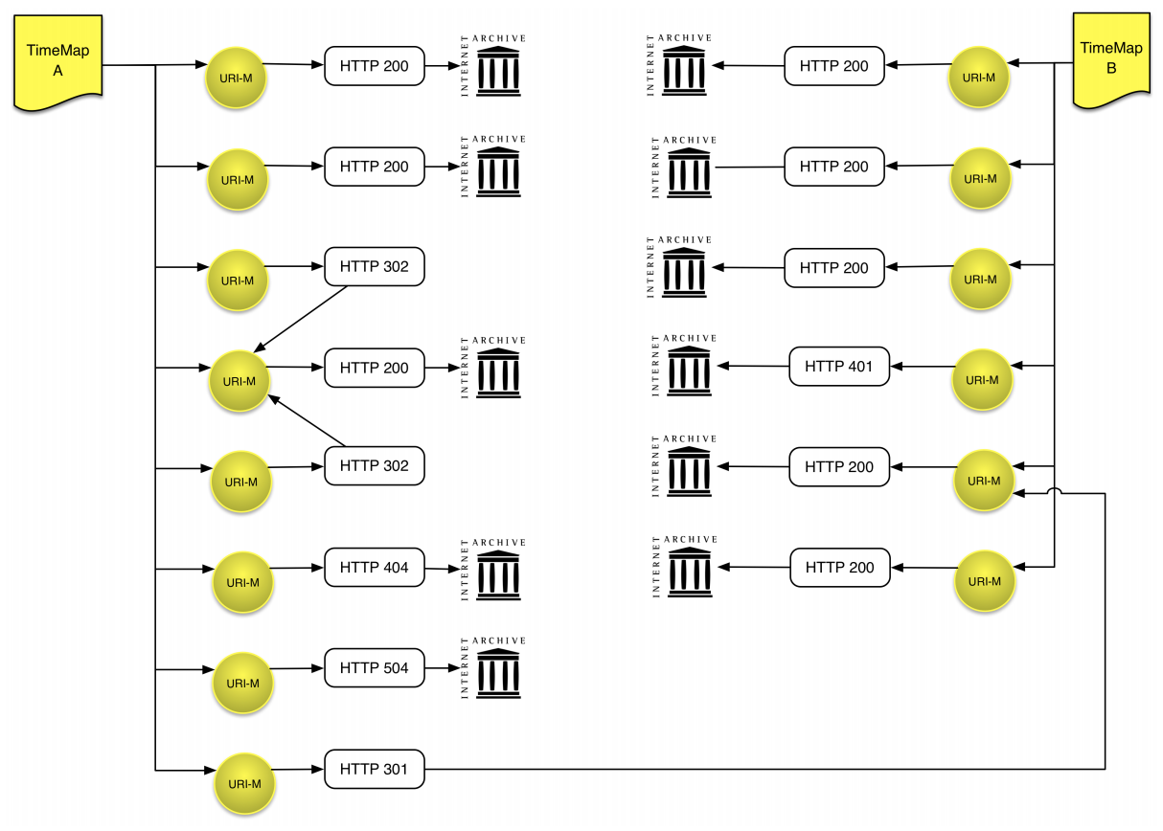
A Framework for Aggregating Private and Public Web Archives¹
Lots of software baggage to solve/mitigate replay problems
Mixing private/public sources (Aggregated TimeMaps)
Access to private captures beyond URI dereferencing (using OAuth2)
Query Precedence and Short-Circuiting
Show archival sources are preferred to others
Syntax and semantics for expressing sufficiency of results, optimizing query time
Content negotiation of web archives in dimensions beyond time
Show only captures for google.com that are not redirects (80% of them are²)
Only return captures that are of a sufficiency quality
¹M. Kelly et al., “A Framework for Aggregating Private and Public Web Archives,” In Proceedings of the ACM/IEEE JCDL, 2018, pp. 273-282 ²M. Kelly et al., “Impact of URI Canonicalization on Memento Count,” Technical Report arXiv:1703.03302, 2017.

Slide 12
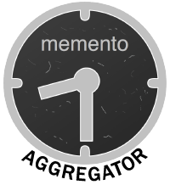
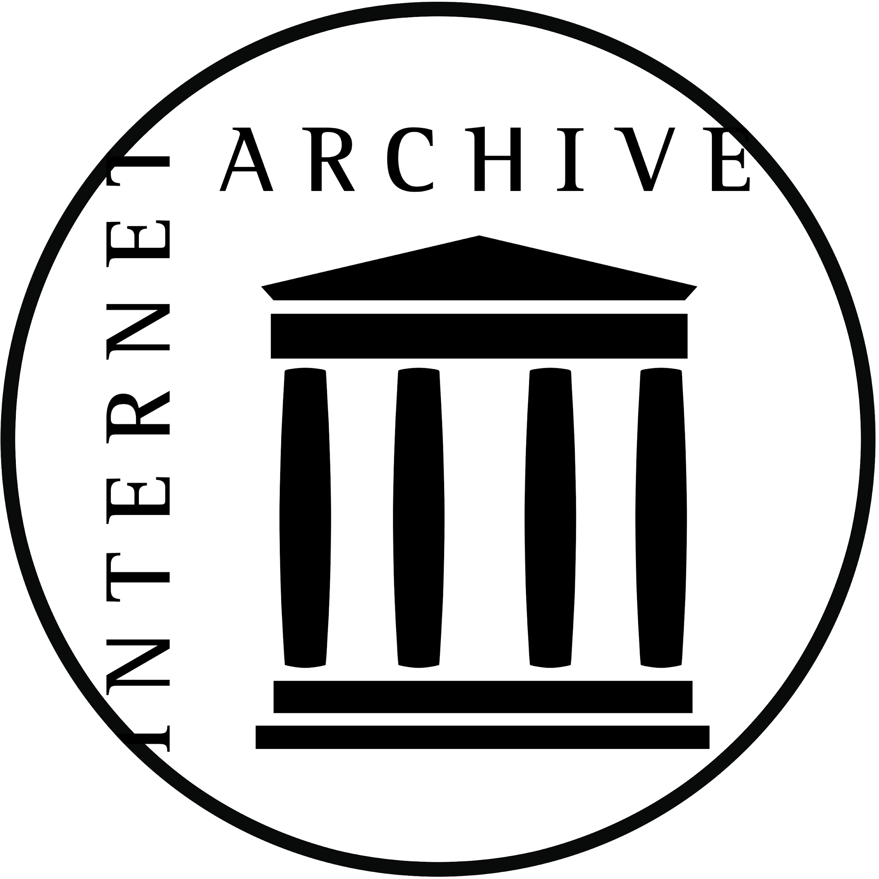
Query Precedence
A URI (e.g., facebook.com) in time, insufficient parameter for querying
More control of querying in series and parallel
1
2
“Check my archive first, then Carol’s, then all public archives.”
3
3
See Atkins’, “Paywalls in the Internet Archive”, March 2018
‹#›

Slide 13
Preservation Beyond Institutions’ Effort
Standard model for systematic user-driven web archiving
e.g., with capture resilience
(there is no standard)
Same URI in time captured from different perspectives (e.g., auth) gets messy
But much of the content users feel is personally important is unsuitable or inaccessible by services
Completeness verifiable, but access to captures beyond publicly available live Web content is an open area
For example:
user wants to specify which sources are used for aggregation, what order should they be queried

Slide 14
Empowering the Client for Archival Access Beyond URI & Time
Beyond traditional replay, enable:
TimeMap negotiation
more expressive instructions¹ for information retrieval from the archive
e.g., “give me archives for URI-R of quality of Memento Damage² (M_{D}) < 0.4
InterPlanetary Wayback (ipwb)³
Leverages Reconstructive, pywb, warcio
Integrated WARCs with the InterPlanetary File System (IPFS)
¹ M. Kelly et al., “Client-Assisted Memento Aggregation Using the Prefer Header,” Presented at the Web Archiving and Digital Libraries Workshop (WADL 2018), June 2018 ² J. F. Brunelle et al., Not all mementos are created equal: Measuring the impact of missing resources, International Journal on Digital Libraries, 16(3-4), pp. 283--301, 2015.
³ M. Kelly et al., “InterPlanetary Wayback: Peer-To-Peer Permanence of Web Archives,” In Proceedings of the International Conference on Theory and Practice of Digital Libraries (TPDL). September 2016, pp. 411-416

Slide 15
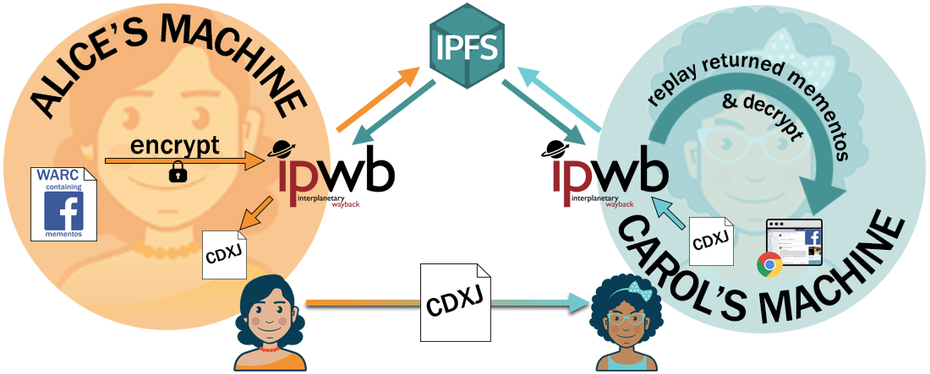
A Model for Private Web Archive Resilience
https://github.com/oduwsdl/ipwb
Secure, peer-to-peer
Mitigates issues of dead hard drive resulting in lost archives
Intended for individual archivists, scalable model for institutions
An imperfect solution that needs more criticism from experts:
peer-to-peer/distrib. systems
privacy and security
M. Kelly and D. Dias, “A Collaborative, Secure, and Private InterPlanetary Wayback Archiving System using IPFS,” Presented at the International Internet Preservation Consortium (IIPC) Web Archiving Conference (WAC) 2017, June 2017.

Slide 16
Goals
Minimize need to know underlying system
Unnecessary implementation detail for users: baggage, barriers, and resistance
Minimize jargon in UI and usage instructions
Distill down usage examples to appeal to initially unforeseen use cases
KISS interfaces
Needed collaboration with UI/UX experts and designers
Does the software you use/build do this?

Slide 17
The (Unfortunately) Common Thread
pywb warcio
Build on others’ projects to progress innovation
ipwb: built using WR’s pywb, WR’s warcio, and Reconstructive
WAIL: built using OpenWayback, Heritrix, MemGator
WARCreate: no prior reusable JavaScript libraries (ca. 2012)
Novelty where necessary, stop reinventing core implementations
Open source is good but hard to sustain without financial backing
Grants expire
Passion projects go idle

Slide 18
Conclusions: Progress and To-Dos
Archival quality captured from tools has drastically improved recently
Advancement in tools using headless browsers internally for archiving
Institutions are receptive to progressing open source tools
✓ To-Do:
Facilitate reuse instead of reinvention
Programmatic collaboration from institutions to projects beyond their own creations
Rethink of web archiving beyond submitting URIs (e.g., seeds), e.g.,
Personal web archiving
Archiving by-value
Open to discussion on how to make continued tool development sustainable
Figures CC-BY-SA, Agata Krych
Transformations available

